Slide 1
Mechanical Engineering Technician (MET)
Date: ________________, 2018
Location: Anishinabek Employment & Training Services boardroom
Thunder Bay, ON
Notes:
Good day/morning
I’d like to welcome you to our information session, affectionately referred to as AMT 101
My name is: ____ and I am a :___________ with the AETS Mino Bimaadiziwin pilot project (pass out your business cards too). I’m really happy to be able to share with you today some information about our new AMT training program.
I would ask that you please fill in our sign-in sheet with your name, email & phone number as we get started
If there are any questions as we go along, let me know and there’ll also be time at the end of the session for questions
If there’s a question that’s a stumper/I can’t answer today, I’m going to write those down and I promise to get an answer back to you with your phone and email coordinates.

Slide 2
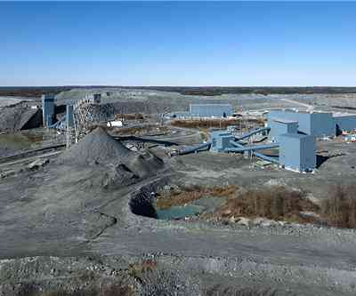
Outline
Your AETS and Mino Bimaadiziwin
MET - Is it right for you?
MET Role, Duties and Career options
What You Need to know
Program courses
AETS Supports
Training date & place
How to Register
Admission Requirements
Questions
Notes:
This is an outline of the topics we’ll be looking at
Some background on AETS and our Mino Bimaadiziwin project
A look at the MET training program
An outline of what being an Mechanical Engineering Technician (MET) is as a career – It’s really a thumbnail sketch and to get more it takes research on your part, speaking with people who are in the career, or at the school to find out more.
We’ll go over what you need to know for MET training, what our project has available to help, and if MET is right for you how to take those next steps to Apply.

Slide 3
Your AETS
Federally funded employment
and training programs and services
Soft services
Workshops
Sponsored programs
Special projects
Mino Bimaadiziwin
Skills Partnership Fund project (to March 2021) for with Life Skills and accredited training in:
Industrial Millwright/Mech. Eng. Technician,
Employment Officer,
Forestry & Mechanized Harvesting,
Line Cutter,
Line Crew Ground Support,
Sawmill Worker,
Aircraft Maintenance Technician Personal Support Worker,
Driver’s Licence and Upgrading
First Nations Pre-Employment and Education program, is an alternative education model,
with access to Teacher(s),
Prior Learning Assessment Recognition and high-school credit classes
Notes:
AETS is your Employment & Training programs/services provider for Citizens on & off reserve in the 1850 area. AETS has provided services over 20 years, under 5 year federal agreements. AETS reports to a Board of Directors representing our communities. AETS provides:
Soft services (Career counselling, job search, resume writing, interview skills)
Workshops (Career Choices, Personality Dimensions)
Sponsored programs (ie Starting a Business, training sponsorships, employability supports, mobility supports, etc.)
AETS can also apply for Special projects funding (ie Skills Partnership Fund) like Mino Bimaadiziwin, running to March 2021, delivering specialized training in areas, such as MET. A related support, the First Nations Pre-Employment & Education program is an alternate education model for off & on-reserve Citizens, with access to a Teacher, PLAR and high-school credits

Slide 4
AETS Communities
Notes:
AETS works with Citizens from these 9 communities of the 1850 Treaty area
both on & off reserve. For Pays Plat east to Michipicoten Joni Michano is your Project Officer. From Red Rock Indian Band and west to Kiashke Zaaging Anishinaabek, Bonnie Cordone is your Project Officer.
Our funded training programs are focussed on our community members and may be open to other First Nations if we have seats that are not filled by our community members .

Slide 5
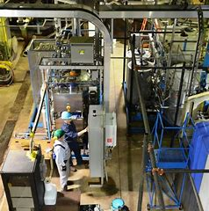
MET – Is it right for me?
Looking for a ?
Career in high demand
Vital and valued in keeping industry
running
METs must be able to
Demonstrate high mechanical aptitude.
Problem solve
Time manage
Communicate in writing and in person
Work independently or on a team, and
Work shifts and with a varied workload
Notes:
Mechanical Engineering Technician is our next training program in this pilot project, and not our last. Deciding on if an MET career is right for you is a process . (Hand out the Career Research Tool.)
Making the right choice to invest your time & energy, you want to be sure, to Know yourself, your: interests, talents/skills, strengths, what you do and do not like to do
Family & friends will have their insights to offer, your hobbies and what holds your curiosity/interest will also give you clues to if this is a good career match for you.
Perhaps you’ve had experience working with small engines, electrical projects, power systems or mechanics, or you enjoy trouble shooting on systems and solving puzzles.
Career Awareness comes from research: online, reading, Career Counselling, meeting Employers/METs, checking out the school, job ads, job trends & prospects, career paths & options to make a SOUND choice for you.
Things to consider include: job satisfaction, the rewards, feeling secure about your choice, and how you can use these skills to make a difference in your life, your family, community and in the world
Then Take Action. Look at skills you need to develop Apply, and get on the path to Learn to Earn.

Slide 6
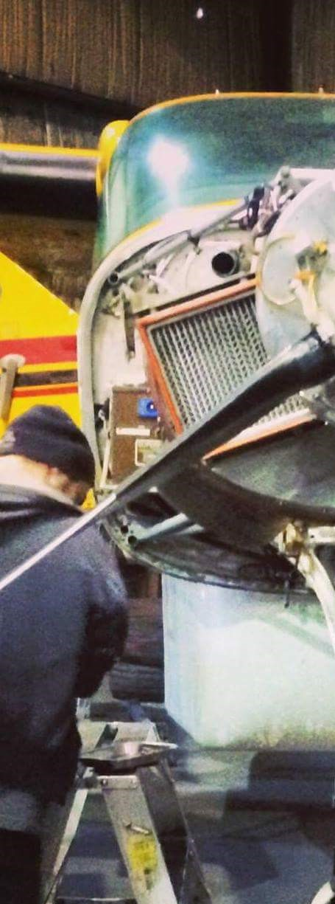
MET Roles
METs may work on one or many types of equipment.
It’s ‘up close’ with the equipment.
There’s a bond of trust with the Employer, workers and customers on the results of your work.
METs add to the life span of very expensive machinery and business operations.
The work of METs includes installations, regular maintenance and unique repair problems.
METs work mainly indoors (in multi-level organizations and unionized settings).
With experience and education, METs can apply to move into jobs as inspectors, teachers, engineers
Notes:
METs can have many roles. The courses will teach what you need to know to write for: OACETT certification registration
It’s investigative & problem solving. There’s installations, scheduled maintenance and preventative maintenance checks. METs review specifications, install and test equipment, check for damaged or defective parts.
METs are a unique resource for keeping high value businesses up and producing.
METs are based out of factories and production shops
There’s no shortage of work for METs. Normally with major businesses, it’s a job that can have opportunities world-wide.

Slide 7
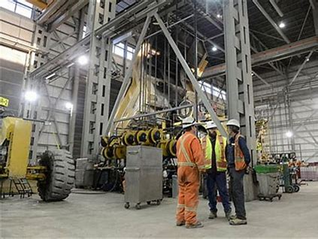
MET Duties
Depending on the setting, METS work includes
Inspections
Installations & troubleshooting
Repairs & replacements
Preventative maintenance
Testing
Keeping work records, ordering parts
Following technical specs, and
regulations.
Wearing protective gear, noise cancelling head
phones and working safely with chemicals,
and large power tools.
Notes:
METs also known as Millwrights are elite craftsmen in a trade respected world-wide
to install, maintain, diagnose and repair precision instruments/machines that cost millions.
They keep industry running and maximize production.
Intrigued?
Millwrights have a keen eye for perfect assemblies/puzzles. Its work for physical and thinking skills .
A Millwright’s work depends on the setting.
Normally they can work in shifts at any hour of the day or night.
Overtime and weekend work is common with this type of job.
There’s a fair bit of on the job learning, but you have to have the College background to start.
METs must be able to perform detailed tasks and record their work, often in a short amount of time. METs have to be able to keep a cool head in stressful conditions.

Slide 8
MET Job Titles NOC 7311
Adjuster, fixer or setter, knitting machines Apprentice indust’l mech, millwright
Ammunition-assembling, loading mach adjuster Bakery machinery mechanic
Boiler-house machinery mechanic Braiding machine setter
Canal equipment mechanic Can seamer machine repairer
Card fixer, setter or grinder Carpet loom fixer, setter
Carton-forming machine repairer Chemical plant service mechanic
Chemical process equipment mechanic Comb fixer, setter
Compressed gas plant maintenance mechanic Concentrating plant mechanic
Notes:
There are many variations in MET related jobs – depending on the Employer, and if you’re work involves sectors like: farming, dairy and food production, textiles, parts and or assembly plants, utilities and power plants, printing, and natural resources like mining, oil, gas and forest products, and there are many different real world job titles that a trained MET can go by. Here are few that are classified alongside MET and related occupations in the National Occupation Classification system.

Slide 9
MET Job Titles
Derrick mechanic Fixer, textile machinery
Equipment mech, nuclear power station Fixer, winding machines
Fabric-shearing machine setter-fixer Factory maint mechanic
Fibreglass-forming machine repairer Flyer repairer
Forge equipment repairer Forge shop mach’y mechanic
Forge shop machinery repairer Gas turbine repairer
Grain elevator maint. mechanic Gum-wrap’g machine mech

Slide 10
MET Job Titles
Heavy water plant mech’l maintainer Hook repairer
Industrial hoist mechanic Industrial mach. maint mechanic
Industrial mechanic, mine hoists Industrial mech, refinery
Industrial mechanic-welder Industrial plant maint. mechanic
Industrial pump repairer Construction millwright
Conveyor repairer Cutting machine fixer
Dairy equipment repairer

Slide 11
MET Job Titles
industrial pump repairer journeyman industrial mechanic
linotype repairer loom changer, starter, setter
loom reed repairer loom technician
looper setter powerhouse mechanic
mail-processing equip mechanic maintainer, oil-drilling rig
Maintenance mechanic oil tool repairer

Slide 12
MET Job Titles
industrial machinery, plants, mill, treatment plants, utilities
marine engine mechanic
master mechanic, mining equipment
mechanic, mine, oil drilling, oil pumping, ore-processing equipment
mechanic, packaging, printing, processing plant
mechanic, rubberizing machines
mechanic, sewage treatment plant, water treatment
oil-drilling rig maintainer, mechanic

Slide 13
MET Job Titles
mechanic, stationary farm equipment, tobacco-processing machines
mechanic, upgrading plant mechanic, water filtration plant
metalworking machinery mechanic mill maintenance mechanic
mine hoist repairer mine mechanic
mule fixer, setter napper adjuster, grinder
needle bed/board repairer
oil pump station mechanic, maintenance mechanic

Slide 14
MET Job Titles
powerhouse mach mechanic preventive maint mech techn
open-end technician ore-processing equip mechanic
oven equipment repairer overhauler,
steam plant maint mech, steam turbine repairer
tannery machinery repairer upgrading plant mechanic
water filtration plant mechanic wire repairer
winder fixer windmill repairer
weave changer welding equipment repairer

Slide 15
MET Job Titles
repairer, steam turbines, windmills rigger, ship
rig mechanic roll builder-repairer, setter
roller coverer roller repairman
rope machine setter ski lift mechanic, repair technician
spinning fixer, frame fixer stationary farm equipment mechanic

Slide 16
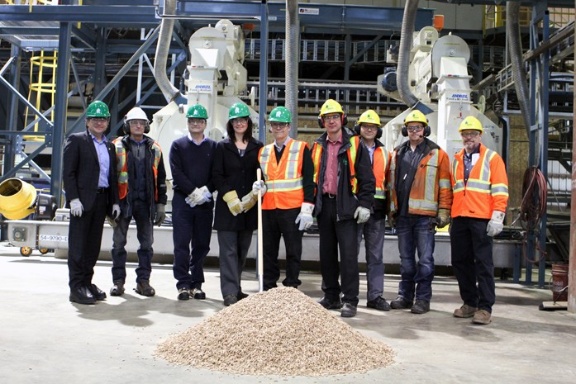
Alternate Career Paths
Inspector
Consultant
Engineering
Designing systems
Own business
Notes:
For some, MET can be a springboard to another career in technical , mechanical, consulting or inspector’s services or along the engineering continuum. METs experience working with local, regional and international companies, and facilities (such as electrical, nuclear facilities), combined with added study (AETS or post secondary funded) can lead into further diploma and degree areas. Another option is to become your own boss, and form your own business.
Self-Employment is an option to start your own business (AETS might be able to help with a self-employment benefit to help as you develop and implement your own business plan )

Slide 17
Labour Market Demand
Ontario has a need for METs and the jobs outlook is bright. On March 6th Resolute had 3 local job ads posted.
Thunder Bay is a centralized hub for ports, airports, wood products manufacturing, water treatment, utilities, wind farms, farming, mining operations, mills and power plants, and engineering companies, any of which can hire Mechanical Engineering Technicians.
Baby boomer workers are retiring.
The government has announced investments in primary/secondary schools on-reserve, housing and water and waste water management.
Major Employers like Resolute are seeking Indigenous workers.
Employers appreciate the value and contributions of First Nations workers.
METs careers have steady work and options for movement.
Notes:
In the Labour Market, METs have valuable skills, and Employers are the buyers. Many factors are involved with the MET Labour Market. Demand for workers, drives up prices.
For 2016 the Federal government budget allocated $8.4 B over the next 5 years towards on-reserve clean water and waste water treatment, schools, health infrastructure and energy systems projects that can require an MET.
Further, Thunder Bay is a hub for utilities and communications, wood and paper products, major employers such as hospitals, education, mining and other interests.
They appreciate First Nations workers’ quality of training and it makes good business sense that workers reflect the communities they serve.
In northeastern Ontario there were 15 MET positions posted on March 6th and opportunities are available Canada wide and internationally.

Slide 18
METs in Ontario
For industrial millwrights and mechanics
in the Northwest region:
680 +people work in this sector
Industrial millwrights and mechanics
mainly work in:
Paper manufacturing : 26%
Wood product manufacturing : 16%
Construction : 12%
Utilities 11%
Mining, and quarrying: 11%
MET Wage Estimates Northeastern Ontario 2014-15
Low | Median | High
$20.75 | $30.00 | $39.79
Notes:
METs in North Eastern Ontario as of March 2018:
680+ METs work in this sector
mainly in :
Paper manufacturing : 26%
Wood product manufacturing : 16%
Construction : 12%
Utilities 11%
Mining, and quarrying: 11%
The wages can range greatly in terms of types of Employers.

Slide 19
On the job requirements
In General
Some tasks may require force used on tools to do the work.
Some jobs involve work in confined spaces or working around large and sensitively calibrated machinery.
You may work with sensitive and high value equipment and need to be able to
protect yourself and
ensure the safety of others
Notes:
Many Employers require a clear criminal records check and also drug testing.
This is because of the importance of the work and the multi million dollar value of the equipment you service.
It’s a protection for you and for the people and business’ who rely on your work.
If any immunizations are required by the College, OHIP will normally cover these costs, and for students who are approved by AETS may be able to reimburse original receipts. It takes time to get immunizations and checks done.
The best place to get a record of Immunizations from the local Health Unit and work through your doctor, a walk-in clinic or the clinic at Confederation College. An outline of the specific MET immunizations needed is available through AETS and also from the College website.

Slide 20
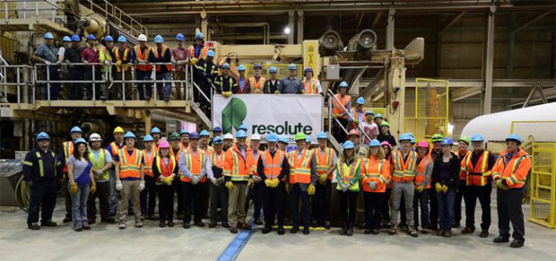
Things you need to know
A 2 year College program (unsponsored during the summer months)
Strict attendance and punctuality in school and work
Personal commitment & dedication
Home work & assignments
Weekdays 9 am – 4 pm
classroom & labs
Notes:
With this program there are some things you need to know
Normally this is a 2 year College program .
It’s a strict program and takes dedication and commitment, drug free and a clear criminal record.
The program is a steady canoe , paddling steady to stay on track and each person depends on each-other
It mirrors conditions in the real world. The Employer, staff team and airline depend on the AMT being focussed ready and on time, reliable and responsible. Its why being on time and attending school every day is important. Lack of attendance is a reason that a sponsorship could be ended early.
The bulk of time is spent in the classroom and in labs at the school to try and to test those skills in different real world type conditions.

Slide 21
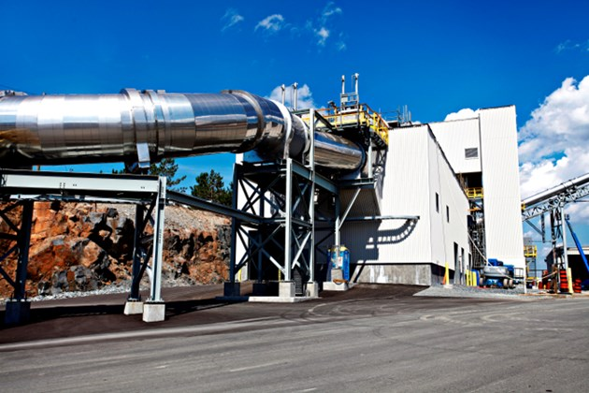
Program Courses
Persuasive Writing,
MS Office
Pre-Techn Physics I and Science II
Applied Math I,II&III
Eng Graphics
Mech Practices
Machine Shop I &II
Welding I&II
Power Transmission I, II &III
Industrial Design I, II
Intro to Electricity
Notes:
Persuasive Writing - Persuasive Writing strengthens writing clearly, correctly, reading and critical thinking to get at the details

Slide 22
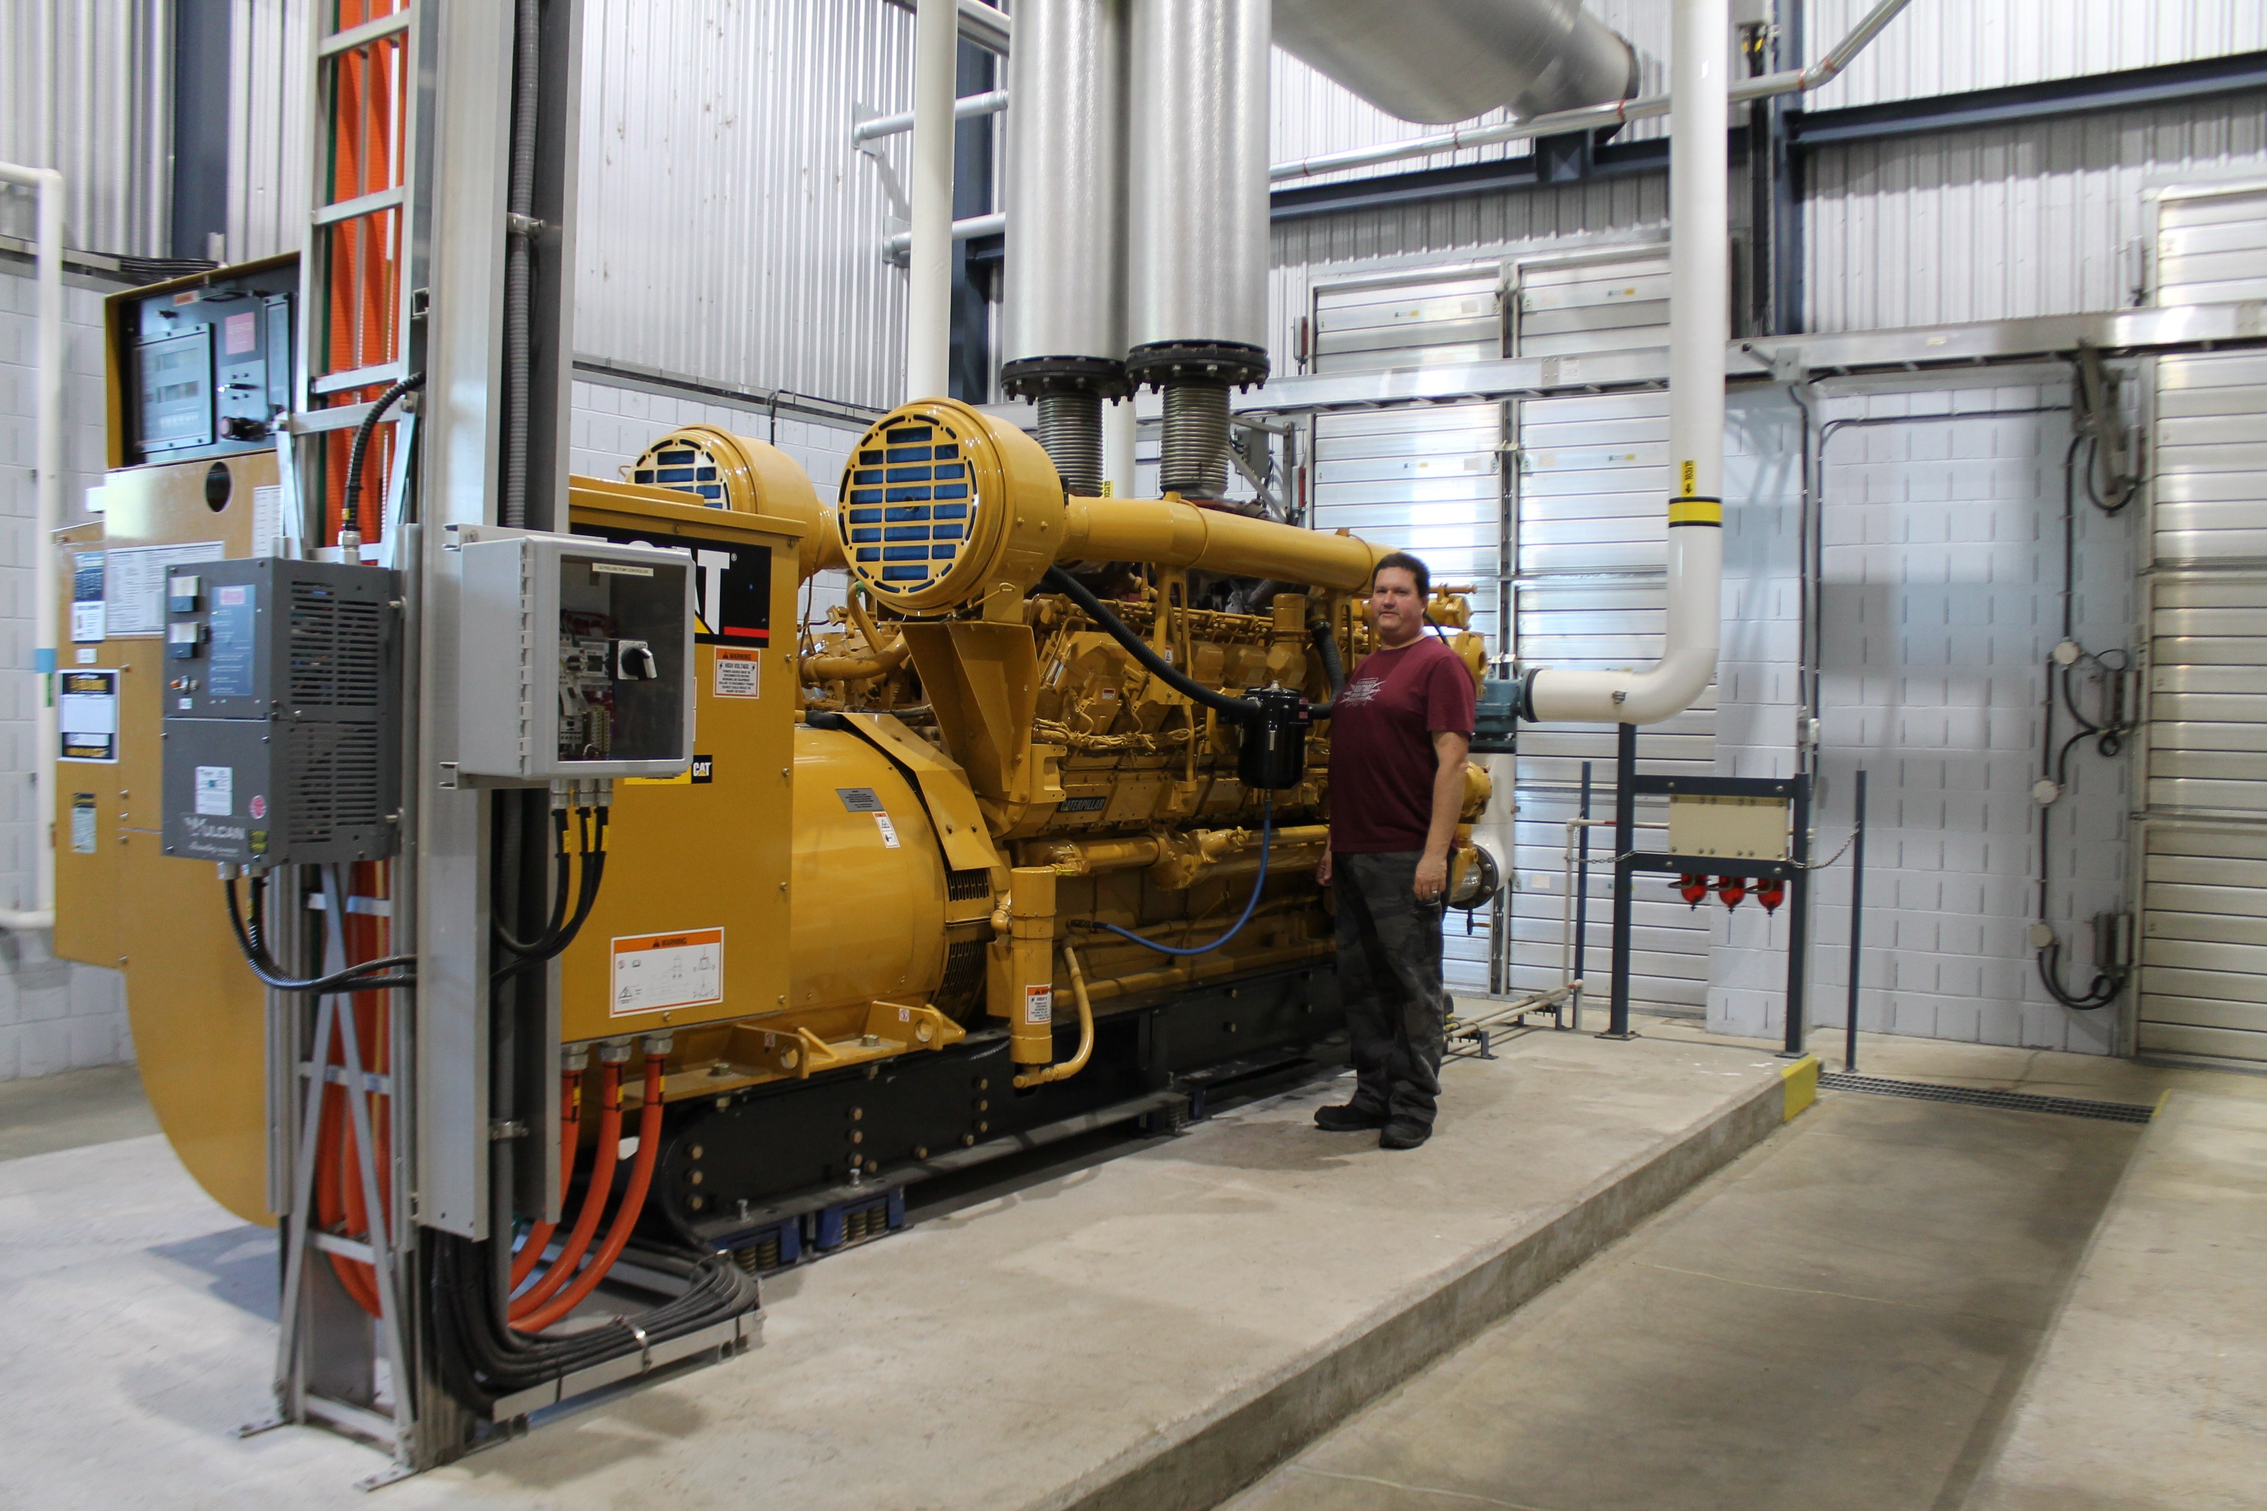
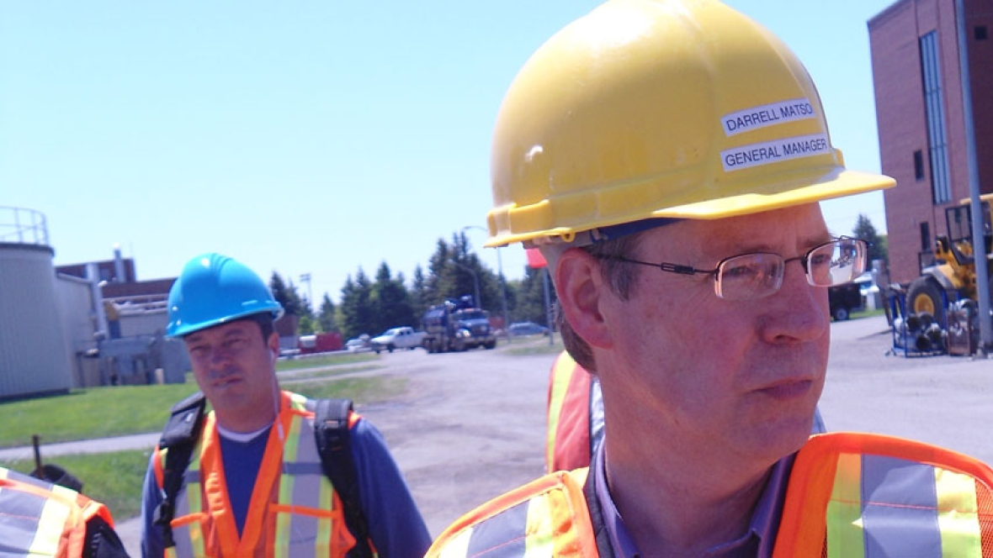
Program Courses
Electives, Statics
Fluid Power & Mechanics
Materials Strength
Thermodynamics
Structural Design
CNC
Notes:
Lab Skills – simulated to practice what you’ve learned in the theory classes

Slide 23
AETS Supports
These supports are available as needed:
Sibley Residence (single)
Tuition & Books
Students pay for stationery
supplies
Living Allowance
Meal Allowance
Bus pass/travel
Uniform & Footwear
Testing costs
Child Care Subsidy
Students arrange for the childcare provider
2 Group Choice
evening events
Travel home - up to 2 trips
Life Skills Coaching
College events
Residence, Apiwin and
Student Support Services
Notes:
While all this is happening a student can expect support from Mino Bimaadiziwin (AETS)
Basically our strategy for success is to address the factors that could otherwise hold a student back.
It’s about being welcome, two-way respect, working together (AETS, Students, College, Employers, Students Support Services , Apiwin, Elders and agencies like NEW).
It’s about Tuition coverage & Books that are ordered/delivered for 1st day of class.
Uniform/shoes are fitted & ordered for you. Pens & paper though, is a student responsibility because otherwise it would reduce the number of students we’d be able to sponsor
Allowances can help subsidize Living, Meals costs and Bus Passes. (We’ll have drivers with vans too.) Child care is a Subsidy, but the student arranges for a provider. It may not cover all of the costs.
For single people coming in from out of town we have Sibley Residence (single only, bed desk, dresser, microwave & mini fridge, co-ed private bathrooms/showers, common rooms & laundry facilities 24/7).
In School its about : Regular attendance (weekly reports), Punctuality: mandatory to keep up with school & placement. Mino Bimaadiziwin staff will provide daily in class contact.
We track results and student satisfaction, through evaluations throughout the training
Tutors & Services are available for: note taking, study skills, Test skills, (Student Success Centre/Apiwin) . It’s about supporting an environment for Teamwork, study groups, and a shared PSW Facebook page. It’s about connections, networking and social events that all helps with success.

Slide 24
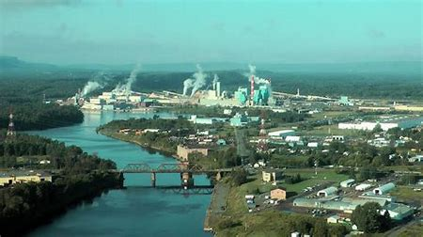
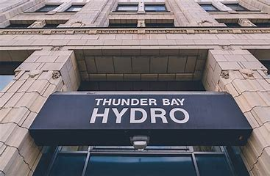
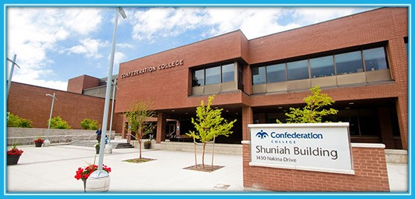
Training Begins – September 4th, 2018
Breakfast and Orientation
Course schedule, books and uniforms
Program overview and your responsibilities
Workshops and speakers
Tour of the classes and labs, and residences
Overview of supports
Notes:
Training Day 1 starts with an orientation session to get to know the School, getting together information and supplies, getting to know your fellow classmates and finding out about the available supports

Slide 25
I’m interested, how do I start?
Application and consent forms
are on the aets.org website
Grade 12 English and Grade 11/12 Math
Status card or letter
Deadline
Fri. July 6th, 2018, 12:00 NOON
Notes:
Applications are due on: (date) Noon
Application package includes:
AETS and Mino Bimaadiziwin Applications, and consent forms, reference check and medical testing, Proof of admission eligibility (transcript), proof of status, career research and essay or alternate visioning format

Slide 26
Admissions Requirements
OSSD or GED AND Gr 12 English (C/U/0)
Grade 11 MCF3M Functions and Applications or
MCR3U Functions or
Grade 12 MAP4C Foundations for College Math or
MCT4C Math for College or University.
Or equivalent : i.e. Mature Student Assessment or
Academic Career Entrance (ACE)
High-school credit classes
and PLARs are offered
through AETS
Notes:
Program Requirements are:
Ont high school diploma or GED at University/College/Open levels AND Grade 12 C/U English.
Grade 11 MCF3M Functions and Applications or MCR3U Functions or Grade 12 MAP4C Foundations for College Math or MCT4C Math for College or University.
or a successful Mature Student Assessment.
or the equivalent credits from Academic and Career Entrance (ACE).

Slide 27
Questions – Thank you
For more information about our programs or how to apply, please call:
AETS Office: 807-346-0307
Joni Michano – Eastern Officer cell 807-631-5838
Bonnie Cordone – Western Officer cell 807-631-9287
Notes:
I’m passing around an Evaluation form (Workshop version) for this presentation session, how we did and your feedback is important.
We use your thoughts to help improve our programs and sessions, and it’s important to our success. The forms can be filled in and left here on the table or with me. You can also contact us about this program and any of our other upcoming programs, or refer people to get in touch with us. We’d be happy to share this information with everyone.
Please do help yourself to the refreshments available and thank you for your time.
Any questions?

