Slide 1
Anishinabek Employment & training services Pre-Apprenticeship training program
Drywall, Acoustics & Lathing (451A) Training Program

Slide 2
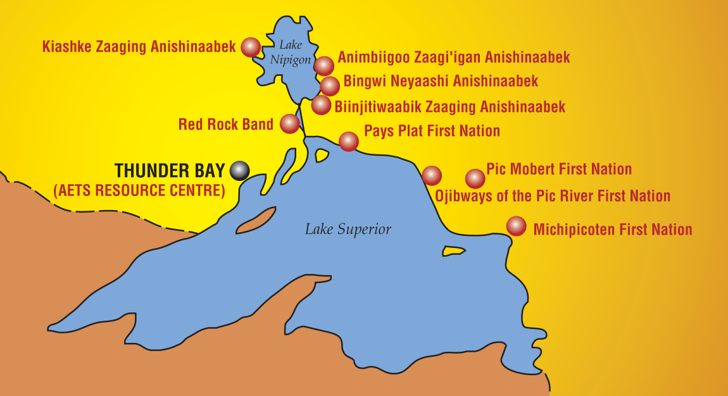
RECRUITMENT
Recruitment sessions have begun and we are starting to travel to our respective communities – Deadline for Applications is May 1, 2020.
Provide in-person information about the opportunity and we started collecting applications.
Red Rock Indian Band
BNA
AZA
Pays Plat
Pic Mobert
Pic River
Rocky Bay
Michipicoten
Gull Bay
*where seating is available AETS may consider Indigenous applicants from outside of the 9 member communities*”

Slide 3
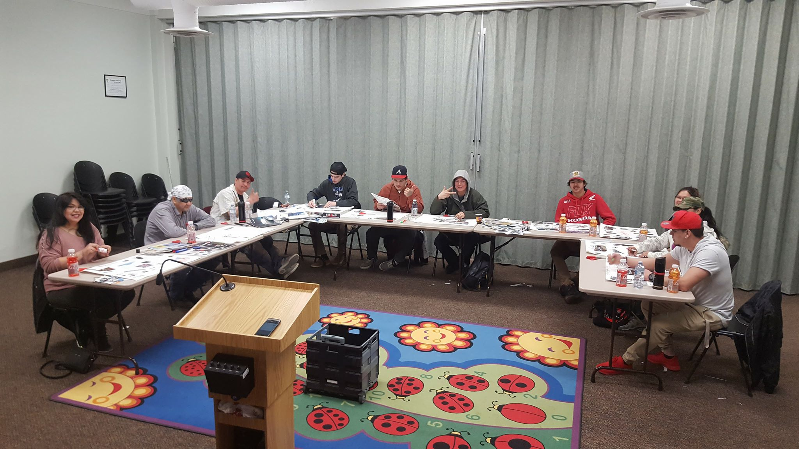
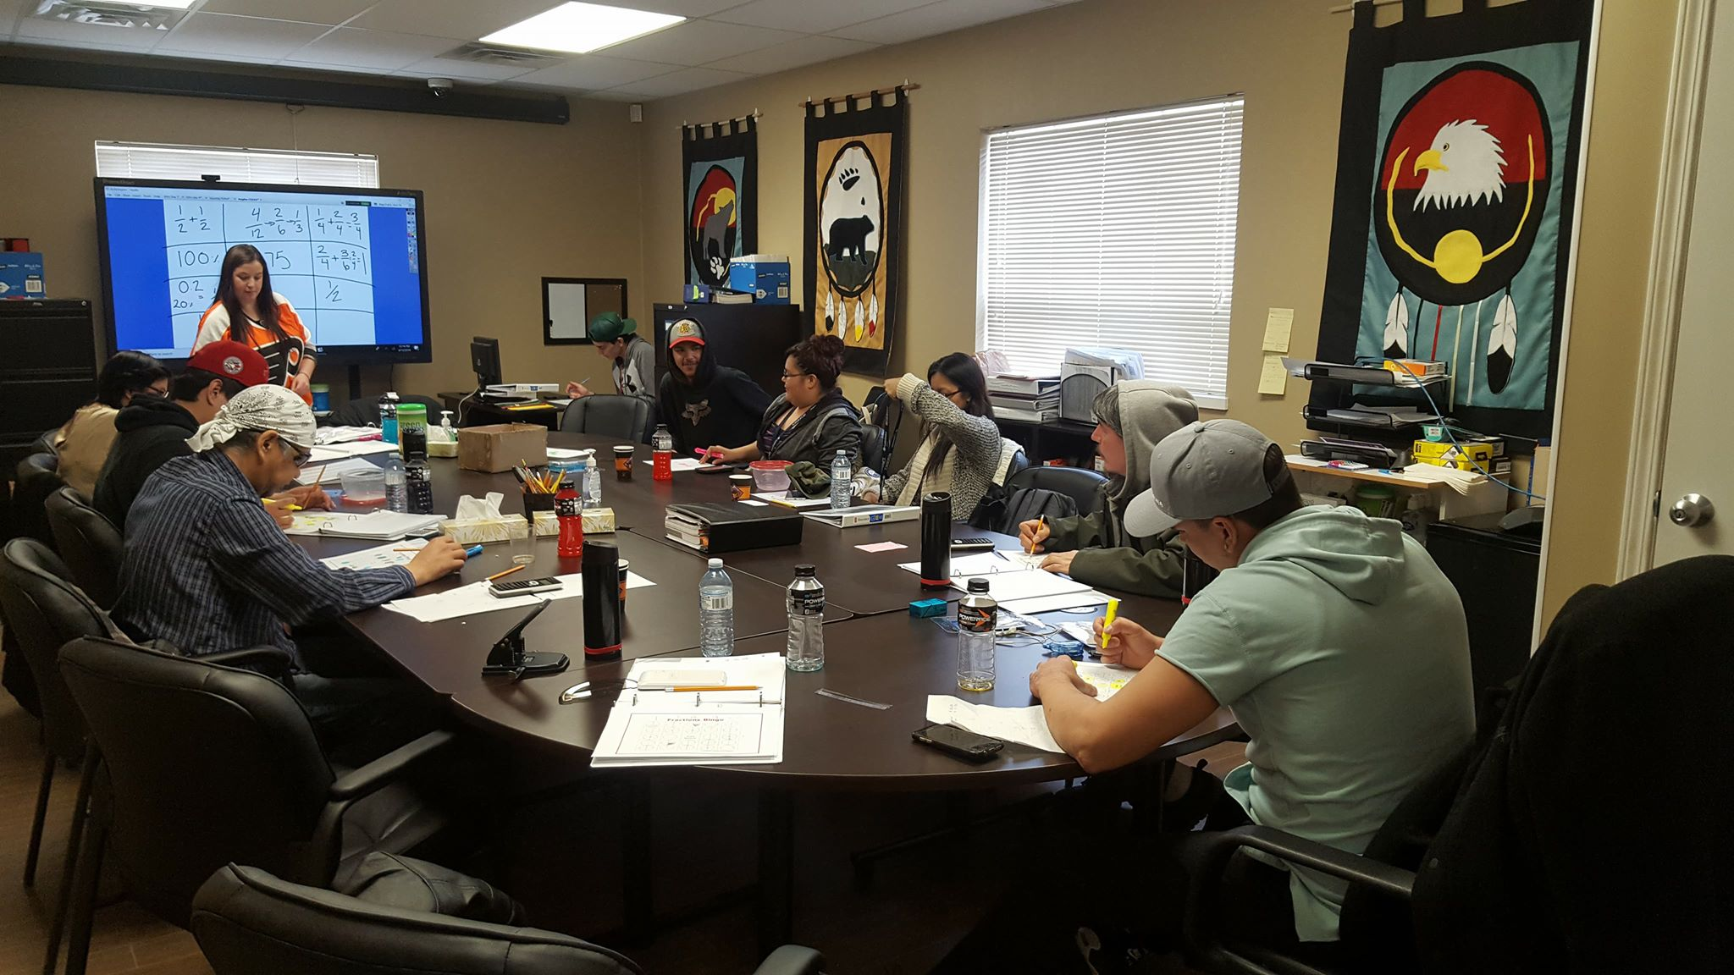
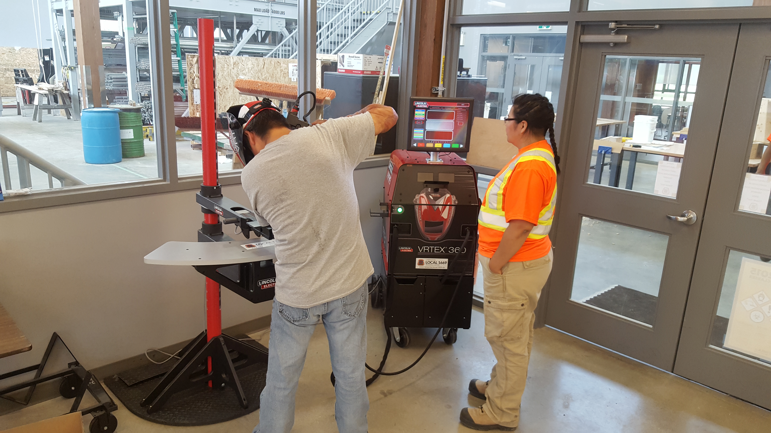
Job Readiness Training
Begins: May 19th, 2020
Pre-Employment Skills Training
Career Exploration
Goal Setting
Time Management
Communication/Interpersonal Skills
Creative Problem Solving
Effective Decision Making
Resume & Cover Letters
Interview Preparation

Slide 4
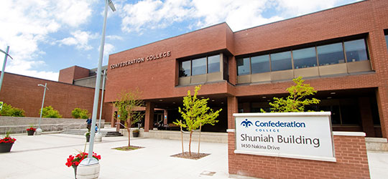
The Program Includes…
Two weeks of welding exposure placement in partnership with Confederation College: June 8, 2020
Eight weeks of Level One Drywall, Accoustics & Lathing with LiUNA: June 22, 2020
Eight week work experience: August 31, 2020 *upon successful completion of in-class training.

Slide 5
Level 1 Drywall, Accoustics & Lathing Training
Begins June 22nd, 2020 for 10 weeks
100% attendance is required
Carpenter’ & Joiners Local 1669
1306 Capital Way, Thunder Bay ON P7B0A3

Slide 6
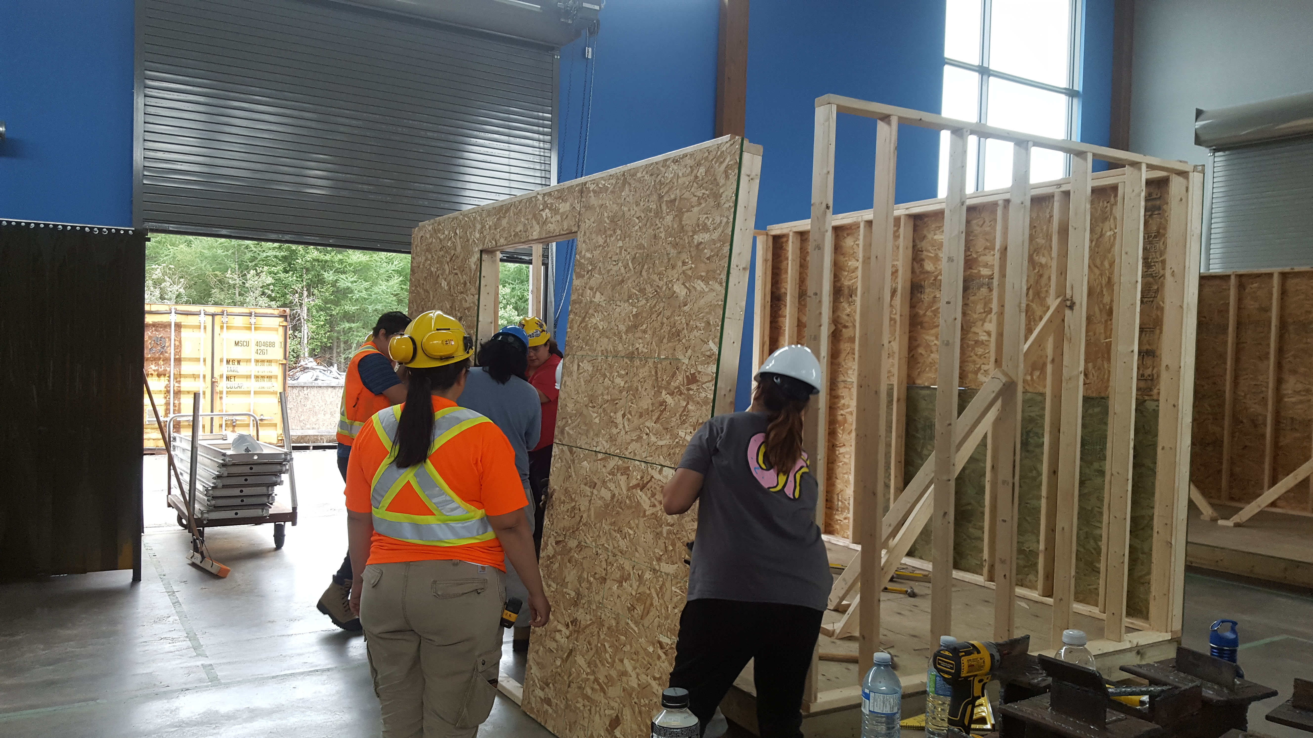
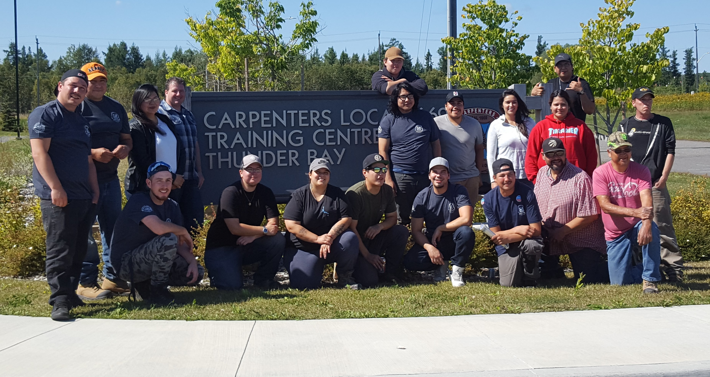
At the Union Hall
Hands on training with qualified instructors helped to prepare are participants for a career as a drywaller.
100% attendance and commitment required!

Slide 7
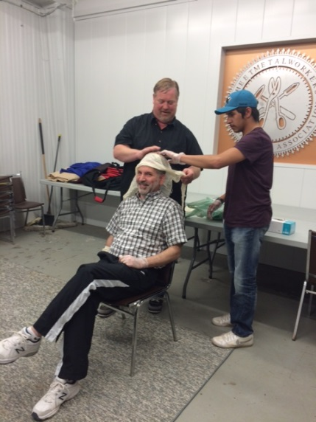
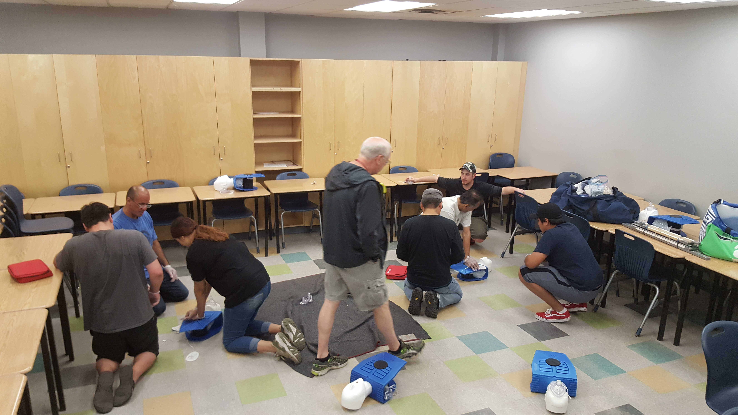
Trade Readiness Training
Workplace Hazardous Materials Information System (WHMIS)
Construction Basic Health and Safety
First Aid/CPR @ AED
Basic construction math

Slide 8
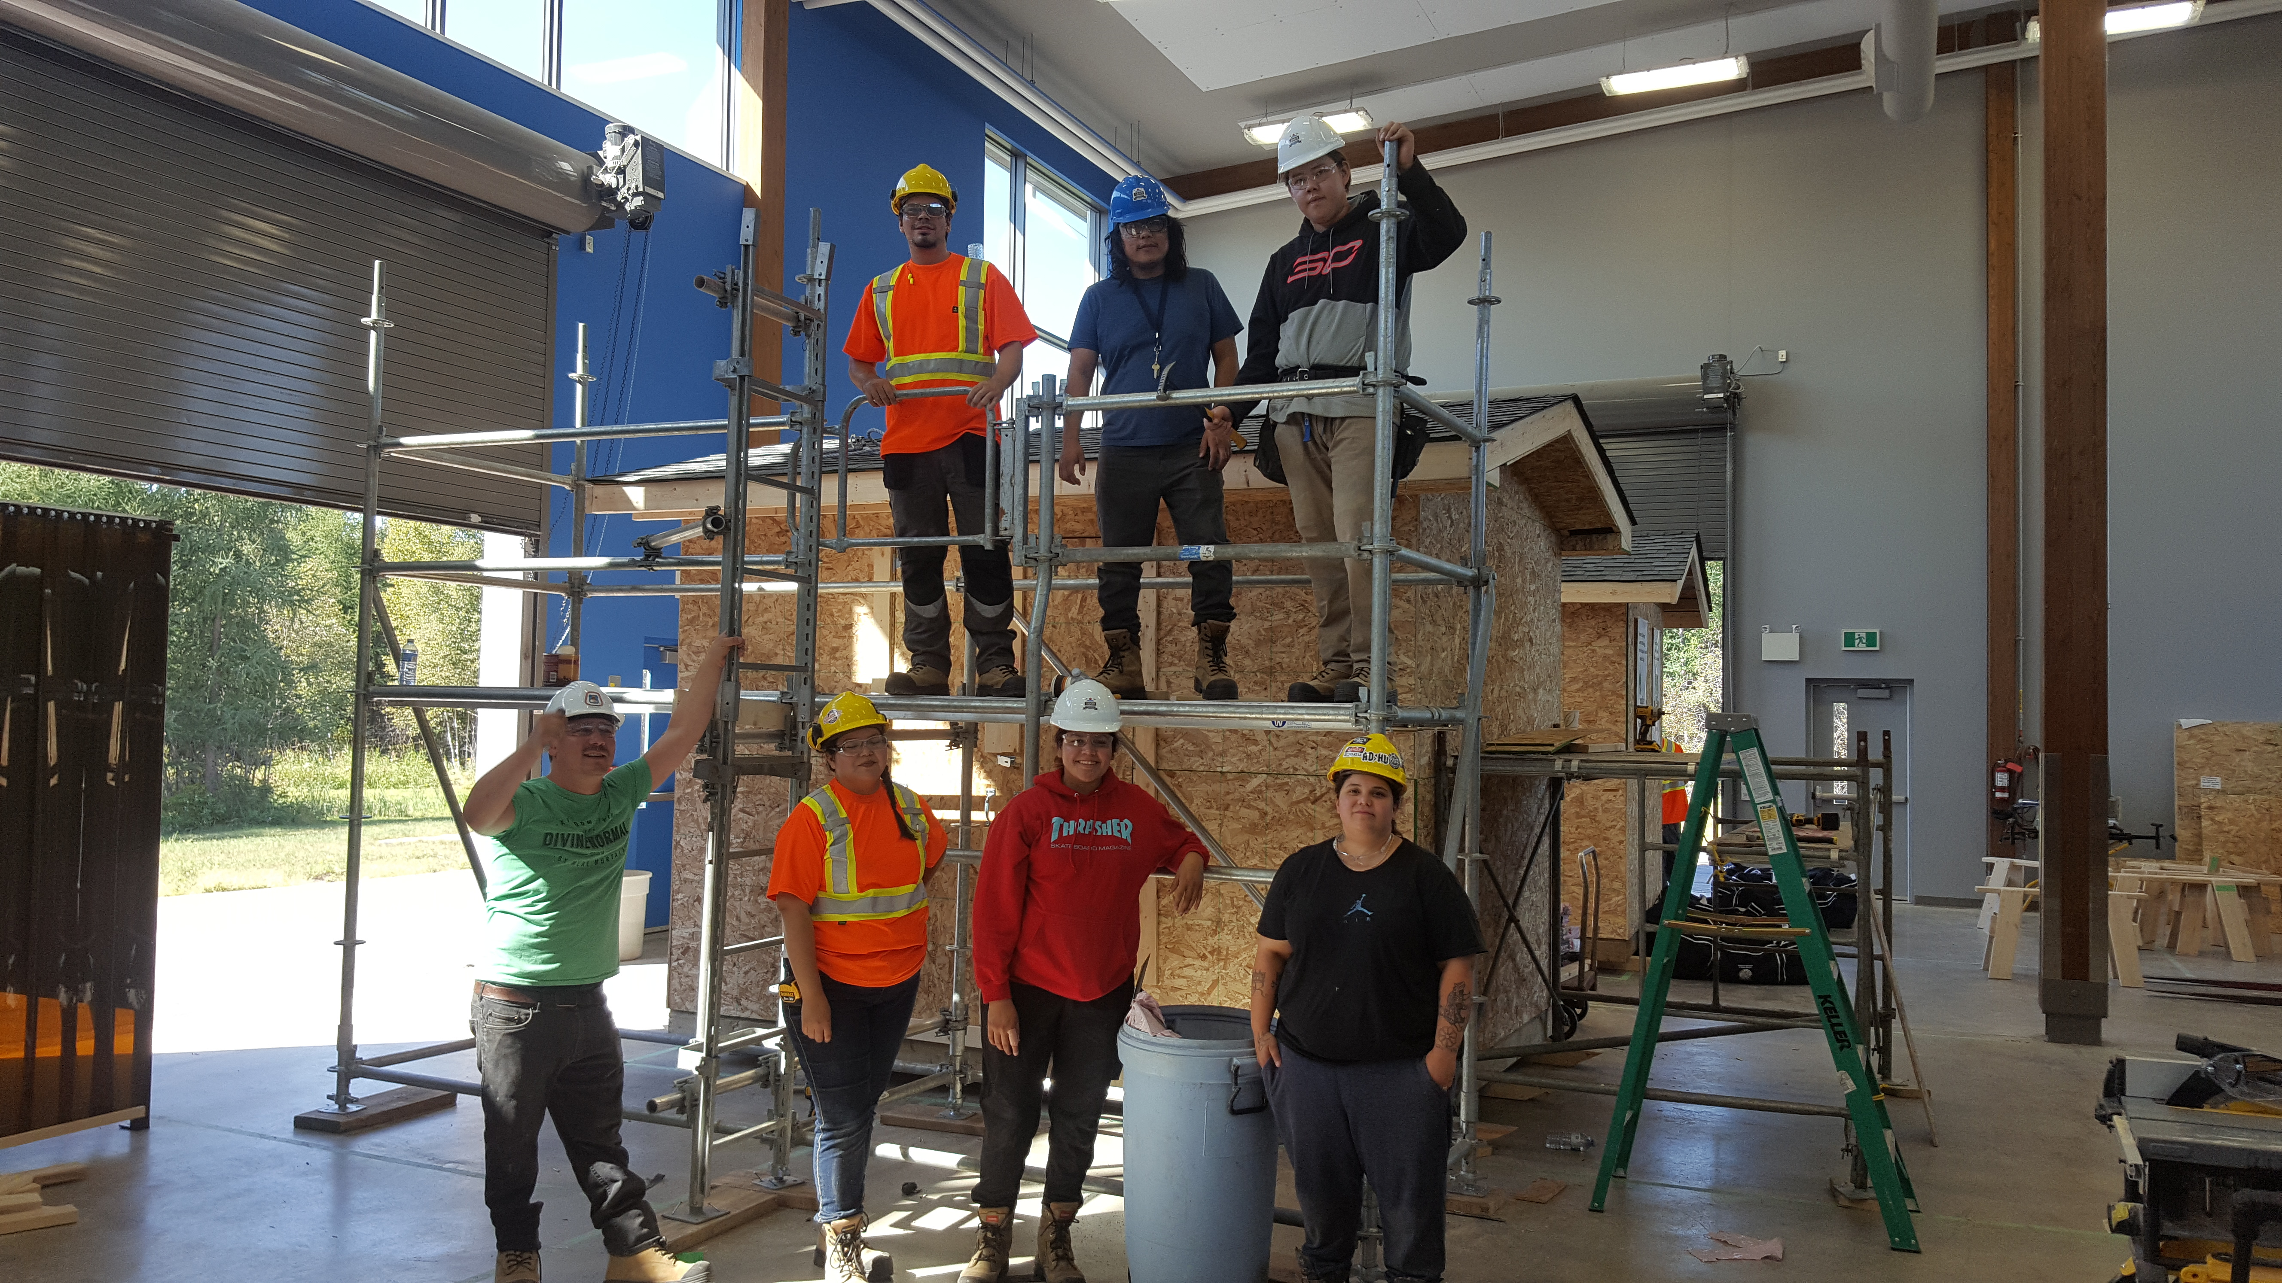
Drywall: Safety, Materials and Tools
Drawings: Plans, Specifications
and Codes
Math: Estimating, Calculations, Basic Construction Math and Layout

Slide 9
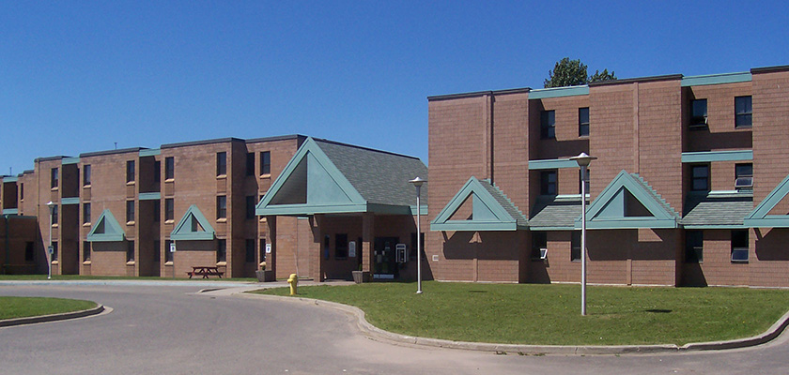
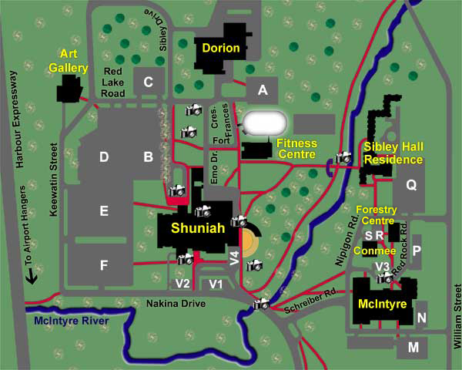
Confederation College: Sibley Hall Residence
Participants will stay at the Confederation College
Residents: Sibley Hall

Slide 10
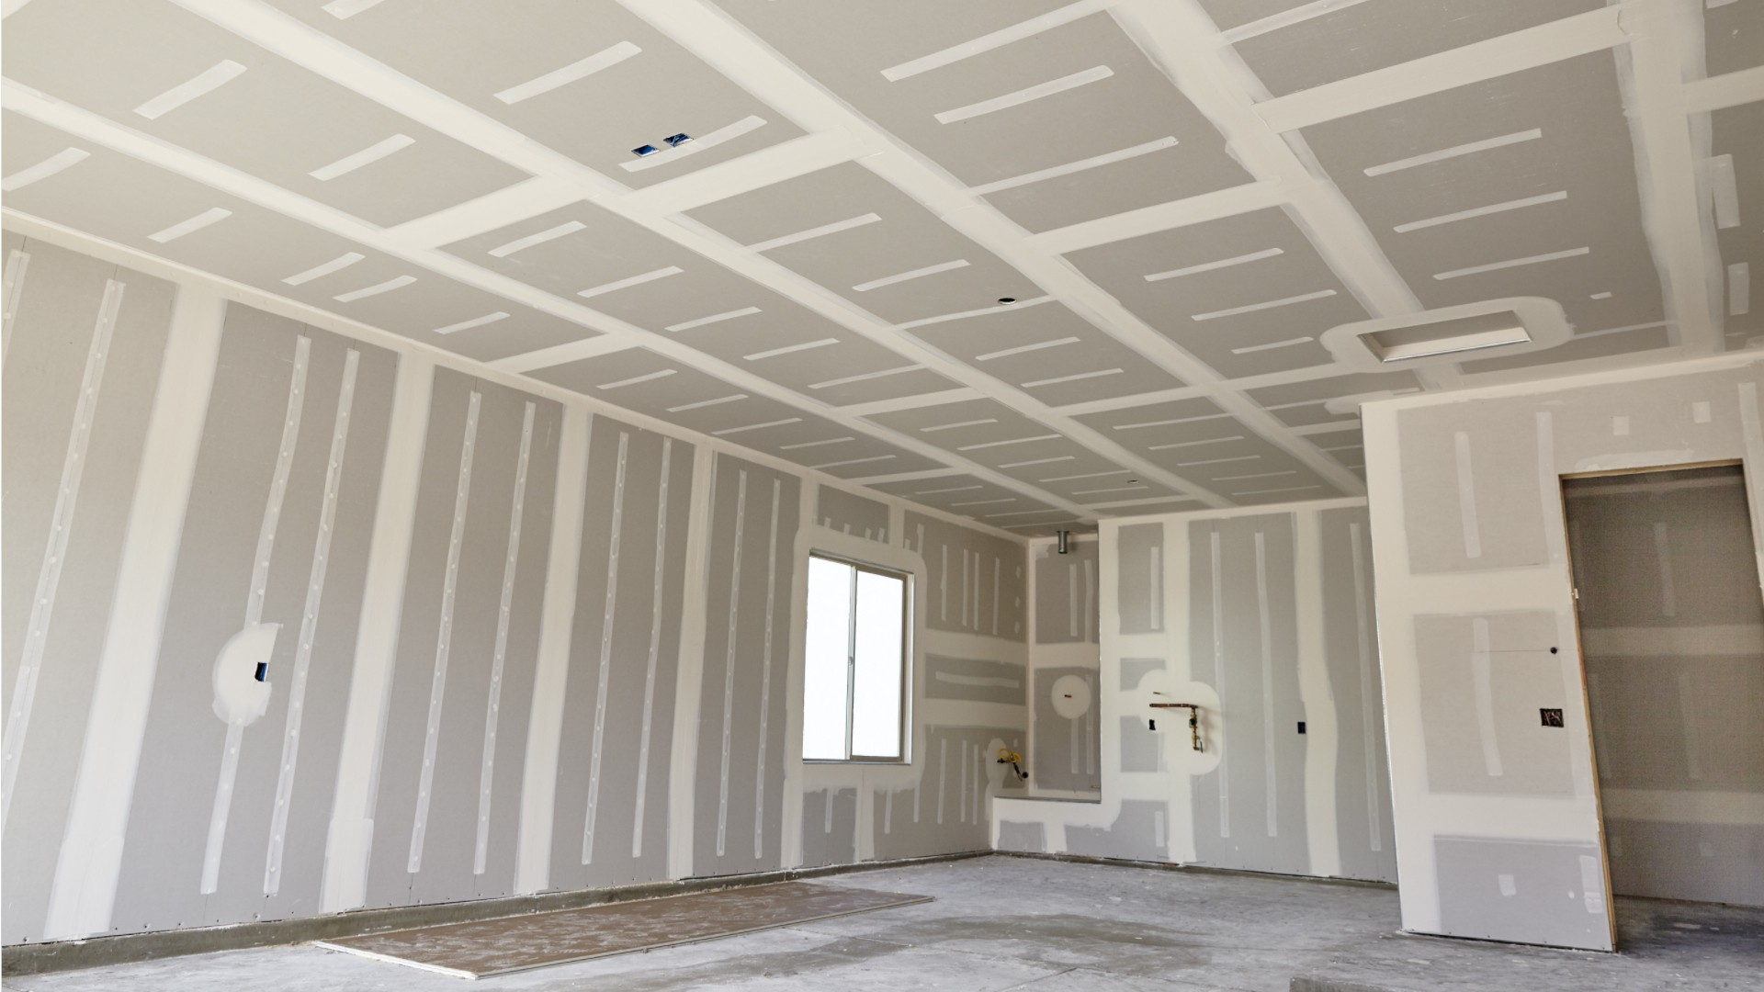
Imagine the Possibilities

Slide 11
Work Experience Placement
Some of our industry partners have included:
Vector
TBT Engineering
Lac Des Iles
Barrick
Northern Finishes
Superior Strategies
Robert Morriseau Contracting
Pic Mobert Housing
PRDC
Rudnicki Industrial
Thunder Bay Hydraulics

Slide 12
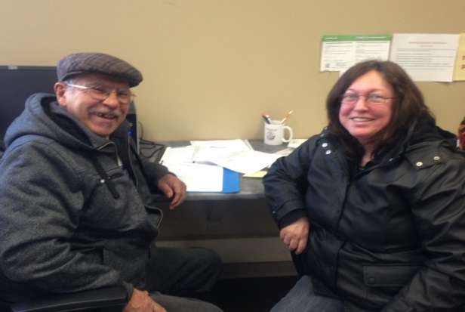
Along With…
Accommodations and healthy meals everyday
A monthly bus pass
Safety gear
Regular evening events
Bowling
Silver City

Slide 13
Applications available on the AETS Website
Program Contact:
Matt Gladu
PATP Project Co-ordinator
(807) 346-0307
matt.gladu@aets.org
Tracey Willoughby
PATP Project Co-ordinator
(807) 346-0307
tracey.Willoughby@aets.org

