Slide 1
Anishinabek Employment and Training Services Pre-Apprenticeship Training Program
Construction Craft Worker (450A)
Training Program

Slide 2
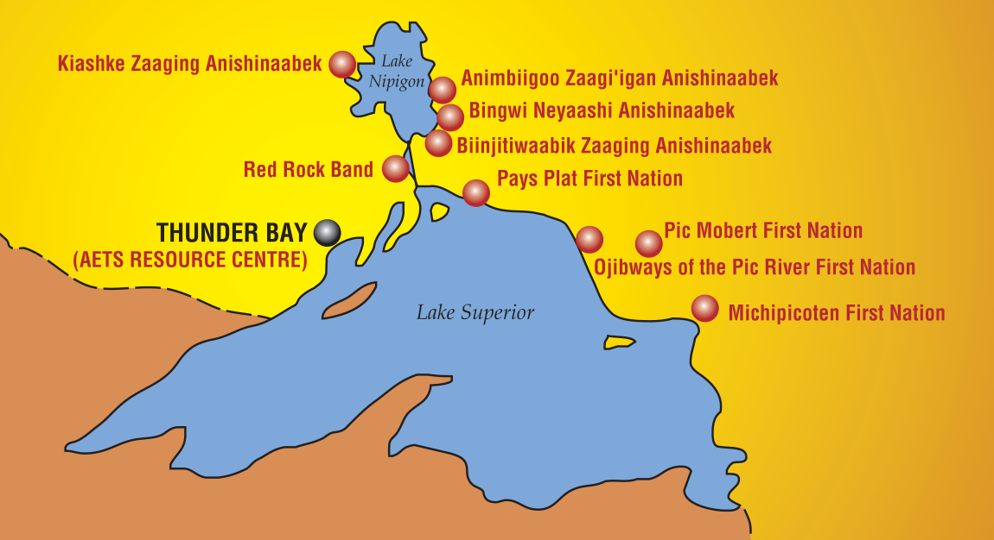
Recruitment
The recruitment sessions have begun and we are starting to travel to our respective communities – Deadline for Applications March 2nd
Provide in-person information about the opportunity and we started collecting applications.
Red Rock Indian Band, BNA, AZA, Pays Plat, Pic Mobert, Pic River, Rocky Bay Michipicoten and Gull Bay
Notes:
Lake Nipigon, Sand Point, Red Rock, Pays Platt, Pic Mobert, Pic River, Rocky Bay and Gull Bay

Slide 3
Then the successful candidates will begin their training…
2015 Students at the Orientation Breakfast

Slide 4
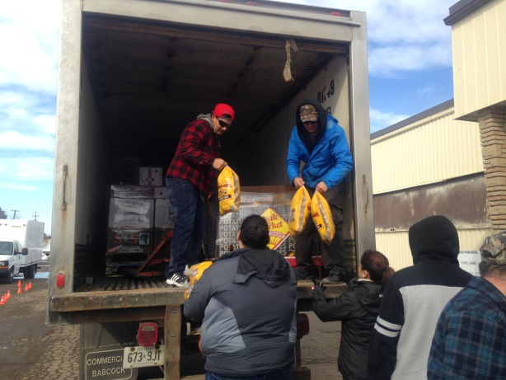
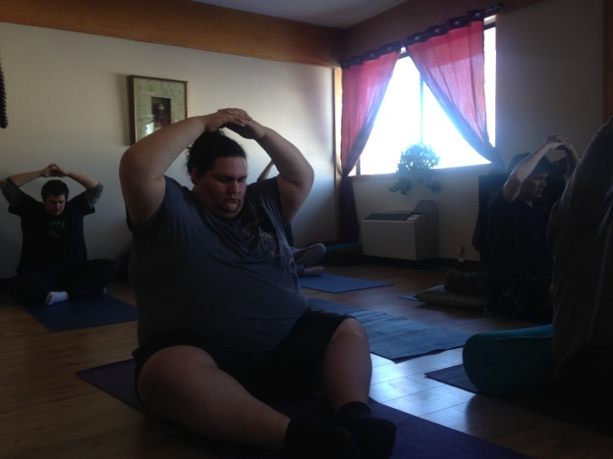
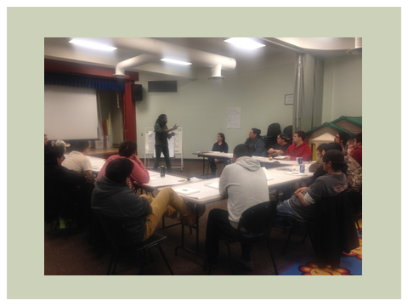
Job Readiness Training Begins April 3rd, 2018
Pre-Employment Skills Training
Career exploration
Goal Setting
Time Management
Communication /Interpersonal skills
Creative problem solving
Effective decision making
Resume and Cover Letters
Interview Preparation

Slide 5
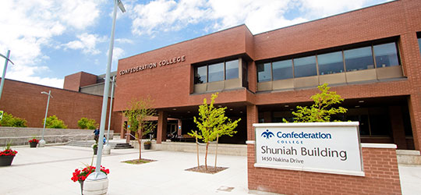
The Program Includes…
Two week welding exposure placement in partnership with Confederation College beginning April 23rd, 2018
Eight Week Work Experience which begins June 25, 2018 upon successful completion of in-class training.

Slide 6
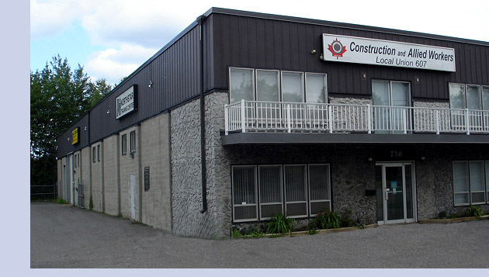
Level 1 Construction Craft Worker Training
Begins May 7th/18 for 7 weeks.
100% Attendance is required
Northstar Training Facility
730 Balmoral St.

Slide 7
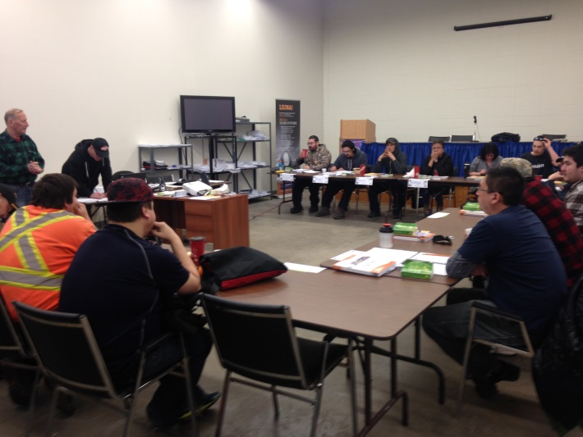
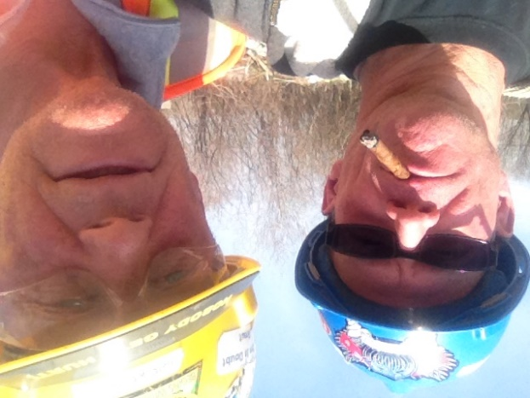
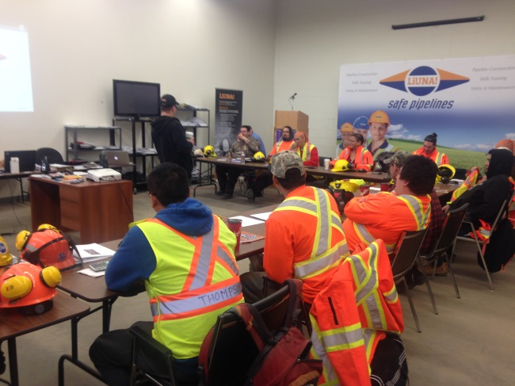
At the Union Hall
Hands on training with qualified instructors helped to prepare our participants for a career as a Construction Craft Worker.
100% attendance and commitment required.

Slide 8
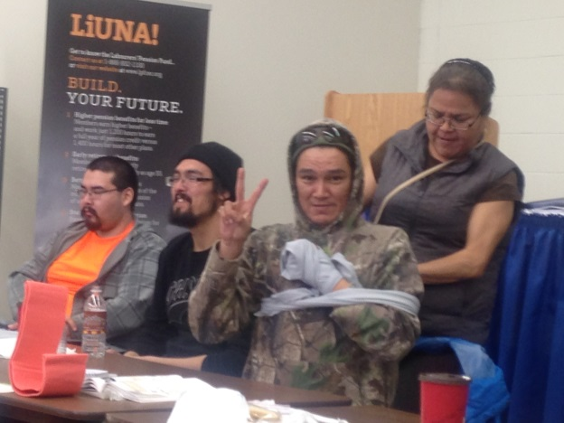
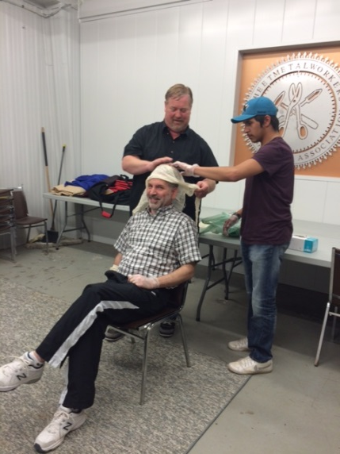
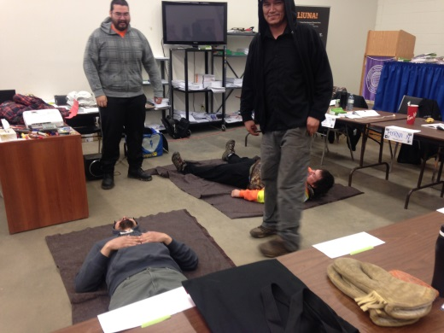
Trade Readiness Training
Workplace Hazardous Materials Information System (WHMIS)
Construction Basic Health and Safety
First Aid/CPR @ AED
Basic construction math

Slide 9
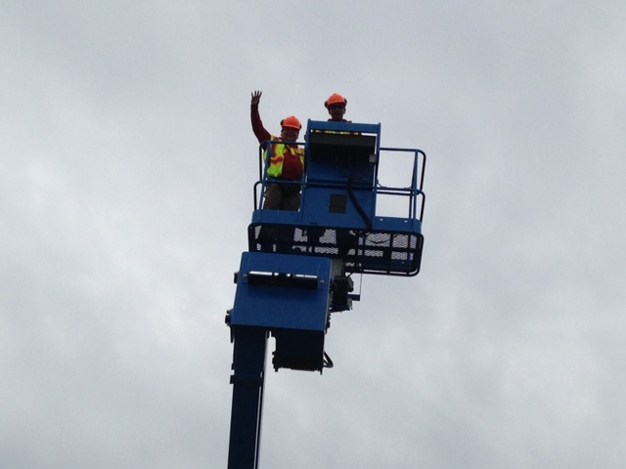
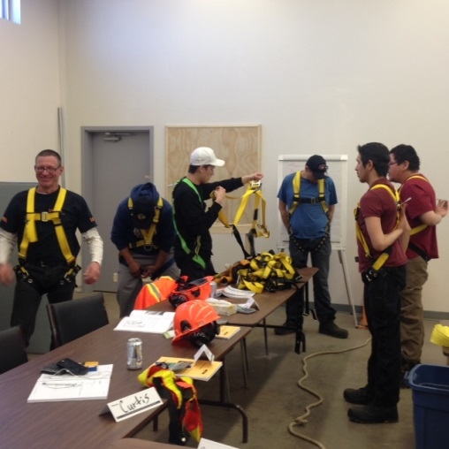
Working at Heights Learning Module

Slide 10
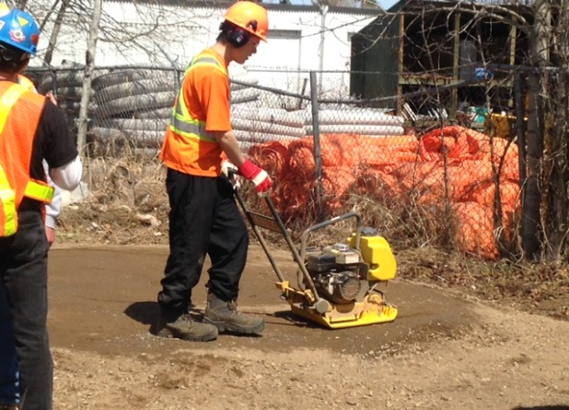
Soil Preparation and Compaction Learning Module

Slide 11
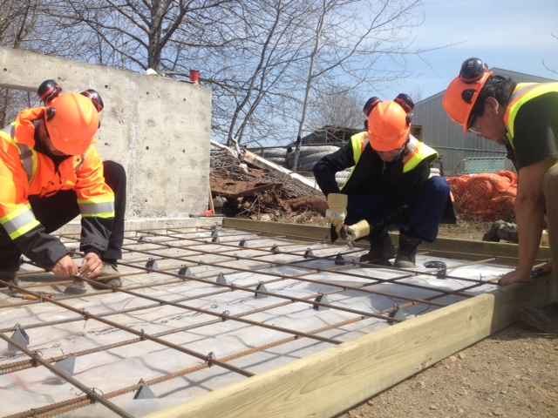
Job built forms and concrete placement
Oxy-Propane Cutting
Notes:
Job built forms and concrete placement

Slide 12
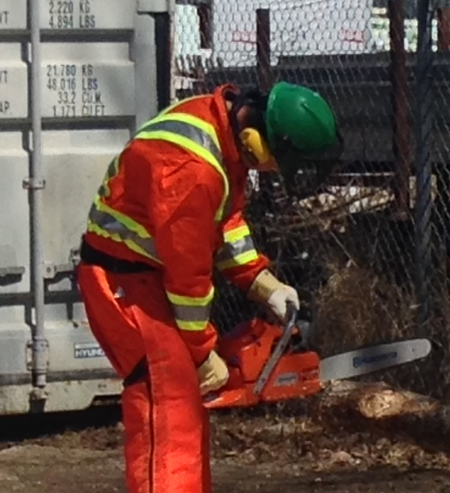
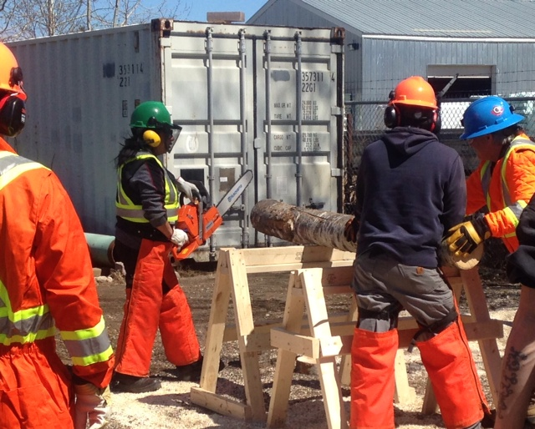
Chainsaw Operation & Maintenance

Slide 13
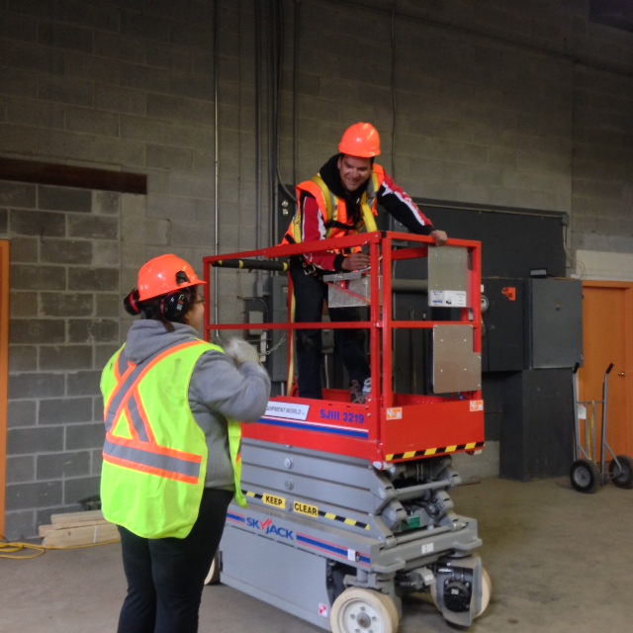
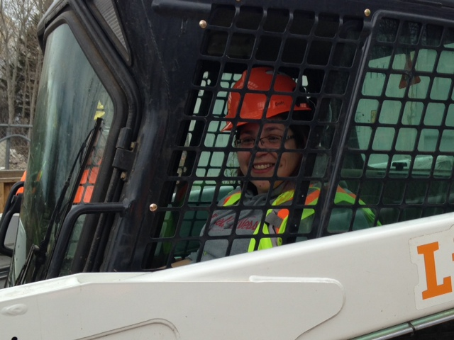
Skidsteer Operations and Forklift Safety and Operation

Slide 14
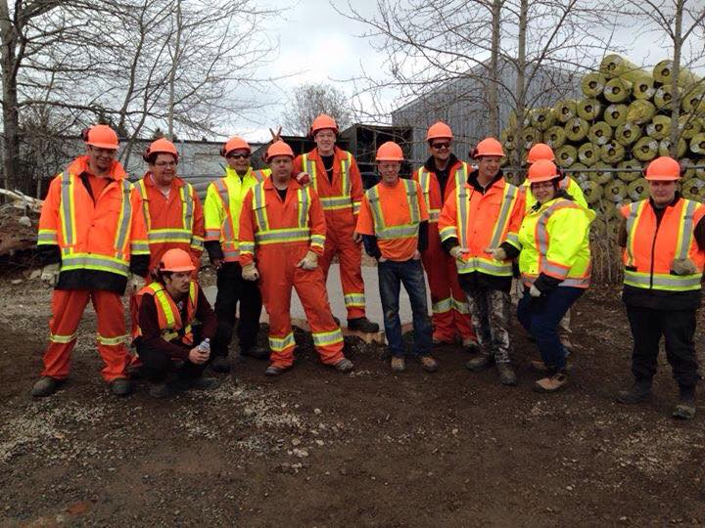
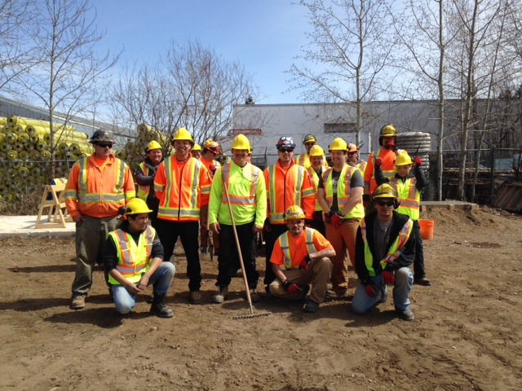
Construction Craft Worker 1
Construction
Craft Worker 2

Slide 15
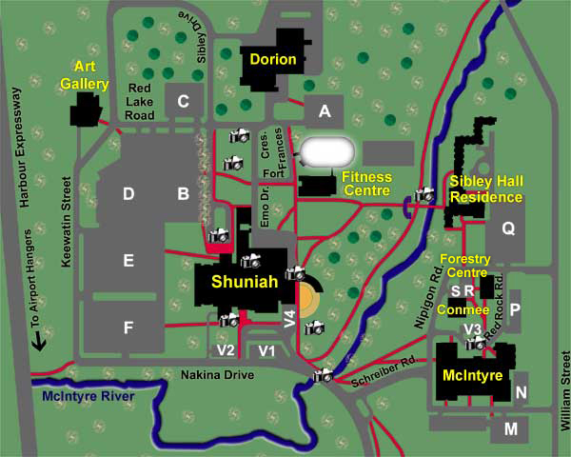
Construction Craft Worker 3
Confederation College: Sibley Hall Residence

Slide 16
Work Experience Placement
Some of our industry partners have included
Vector
TBT Engineering
Lac Des Iles
Barrick
Northern Finishes
Superior Strategies
Robert Morriseau Contracting
Pic Mobert Housing
PRDC
Rudnicki Industrial
Thunder Bay Hydraulics

Slide 17
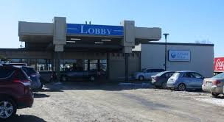
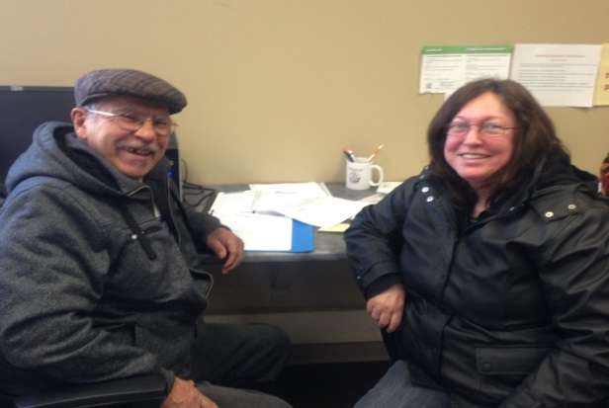
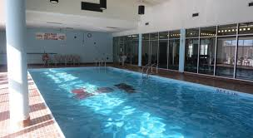
Along with…
Accommodations and healthy meals everyday
A monthly bus pass
Safety gear
Regular evening events
Bowling
Silver City

Slide 18
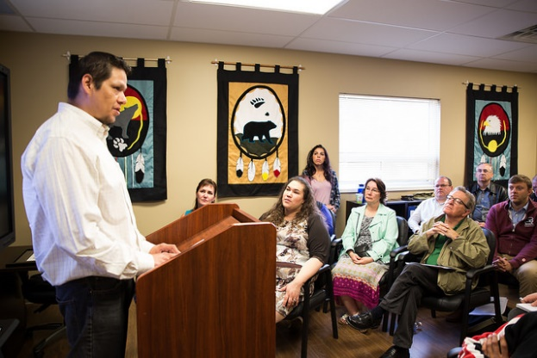
Visit from David Zimmer
We recently received a visit from the Honourable David Zimmer, Minister of Aboriginal Affairs. Sage Thompson, one of our participants gave a speech during the Minister’s visit to share his experiences and the impact the program has had on his life.
As he said, “Completing this program gave me the skills to overcome some barriers that made it difficult in gaining employment in the past by providing me with the essential skills, experience and certifications that Employers seek in individuals they prefer to hire.”

Slide 19
Applications available on the AETS Website
Program Contact:
Nancy Doblej
Project Co-ordinator
(807) 346-0307
Nancy.doblej@aets.org

