Slide 1
Anishinabek Employment & training services Pre-Apprenticeship training program
General Carpenter (403A) Training Program

Slide 2
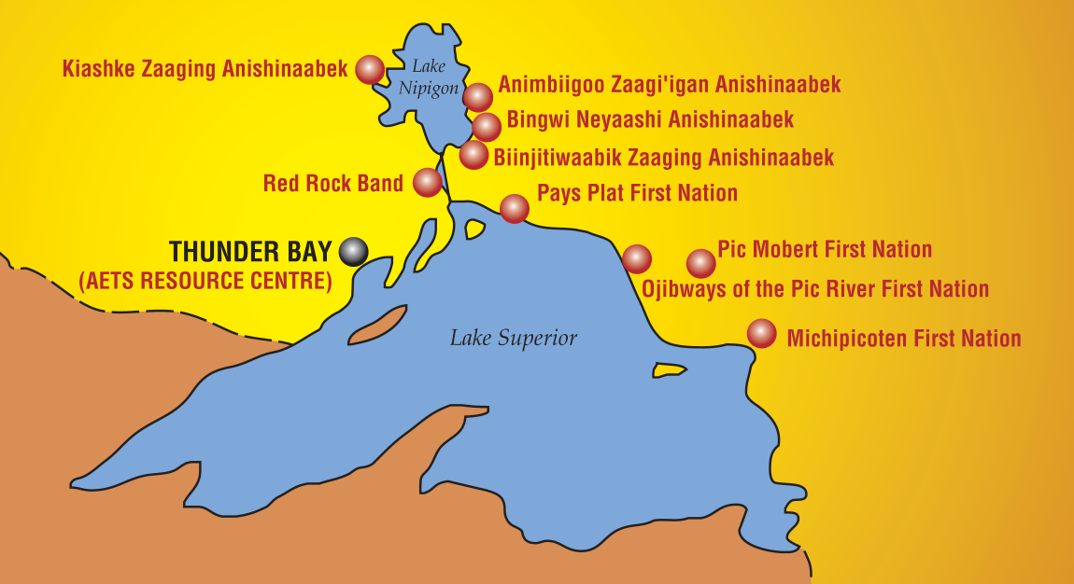
RECRUITMENT
Recruitment sessions have begun and we are starting to travel to our respective communities – Deadline for Applications is May 25th.
Provide in-person information about the opportunity and we started collecting applications.
Red Rock Indian Band
BNA
AZA
Pays Plat
Pic Mobert
Pic River
Rocky Bay
Michipicoten
Gull Bay

Slide 3
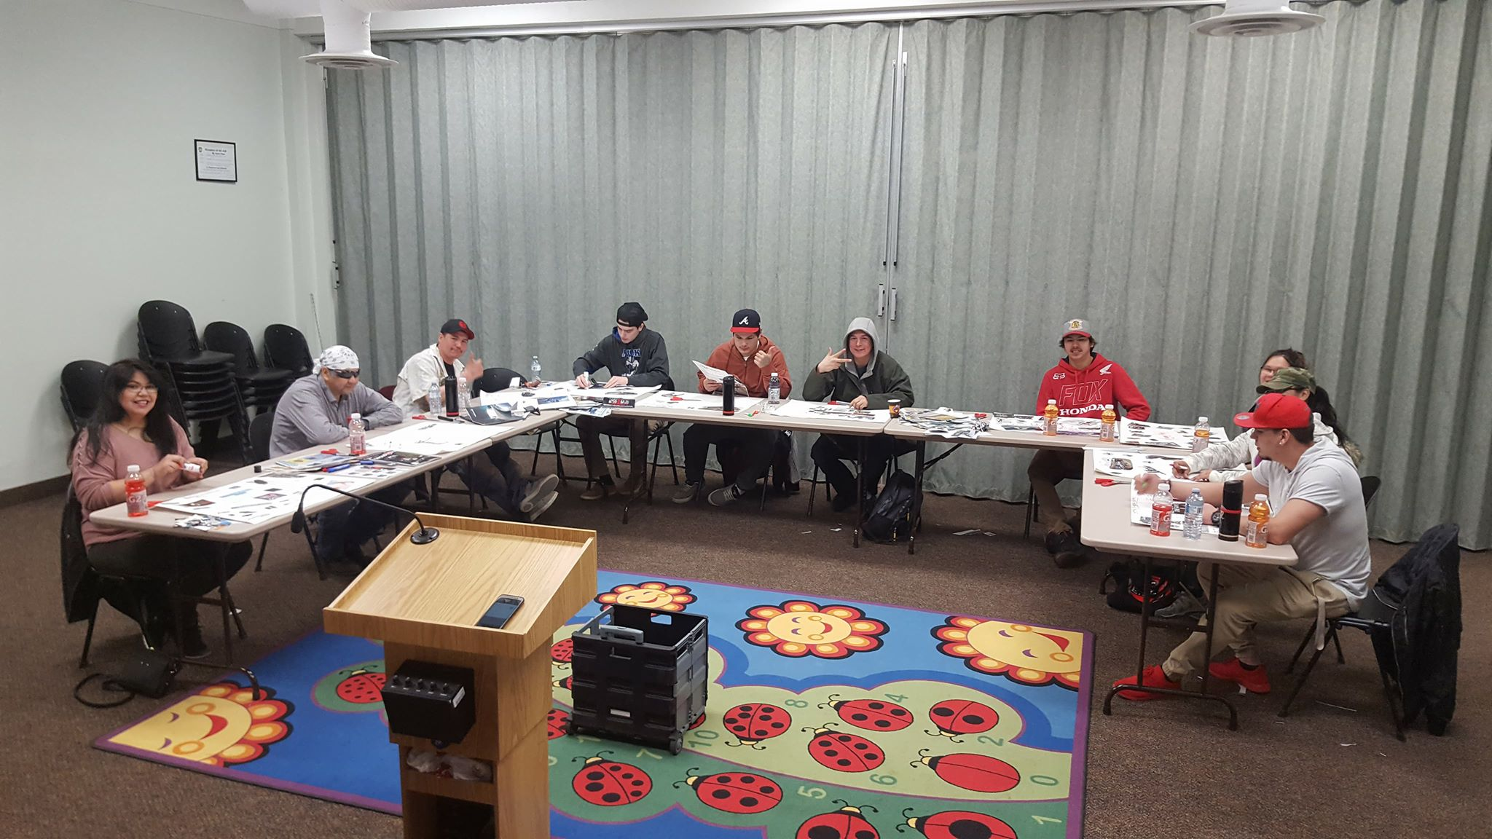
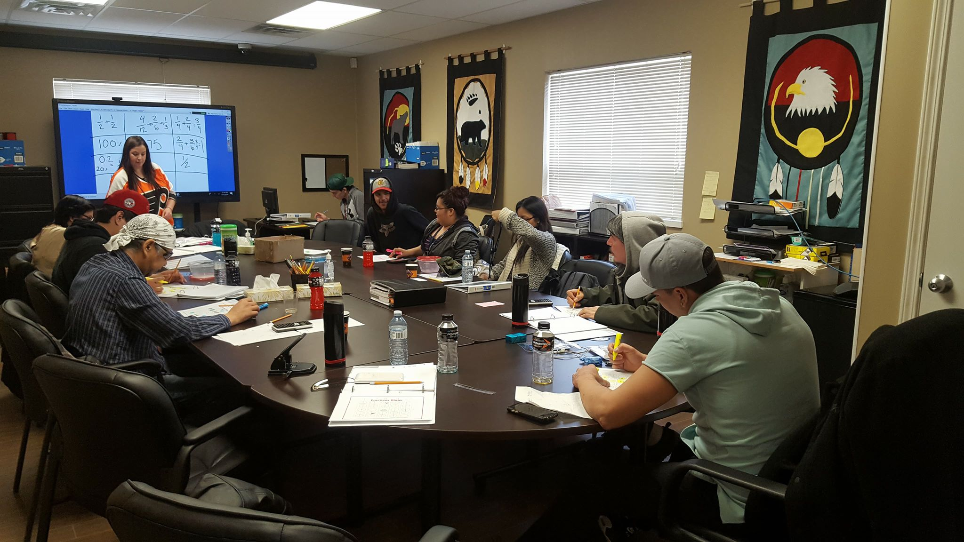
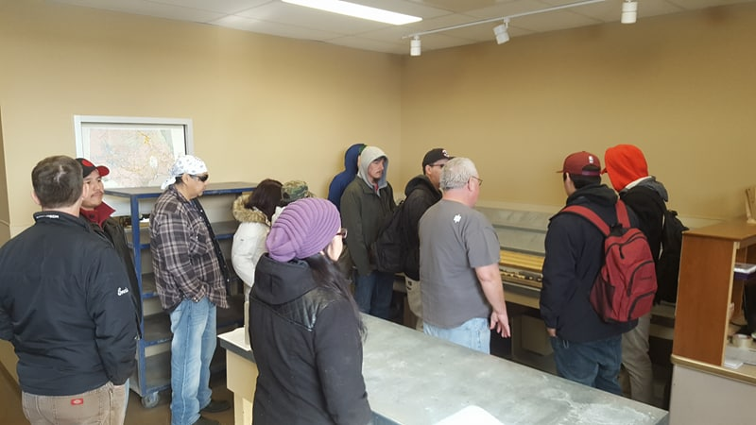
Job Readiness Training
Begins: June 11th, 2018
Pre-Employment Skills Training
Career Exploration
Goal Settling
Time Management
Communication/Interpersonal Skills
Creative Problem Solving
Effective Decision Making
Resume & Cover Letters
Interview Preparation

Slide 4
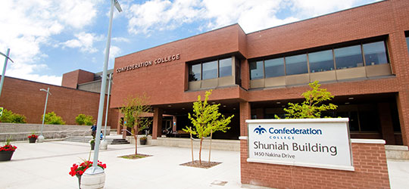
The Program Includes…
Two weeks of welding exposure placement in partnership with Confederation College: July 2nd, 2018
Eight week work experience: September 7th, 2018 *upon successful completion of in-class training.

Slide 5
Level 1 Carpentry Training
Begins July 16th, 2018 for 8 weeks
100% attendance is required
Carpenter’ & Joiners Local 1669
7-929 Fort William Rd, Thunder Bay ON P7B3A6

Slide 6
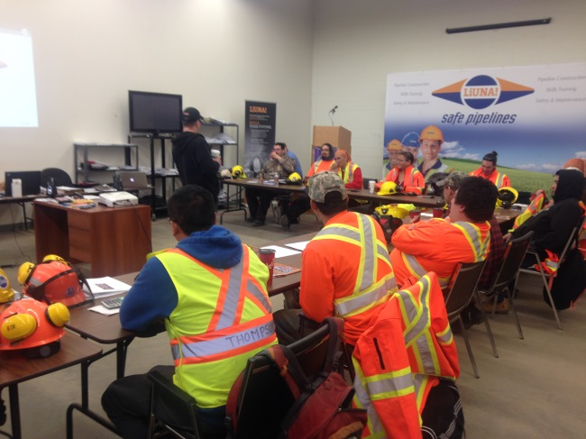
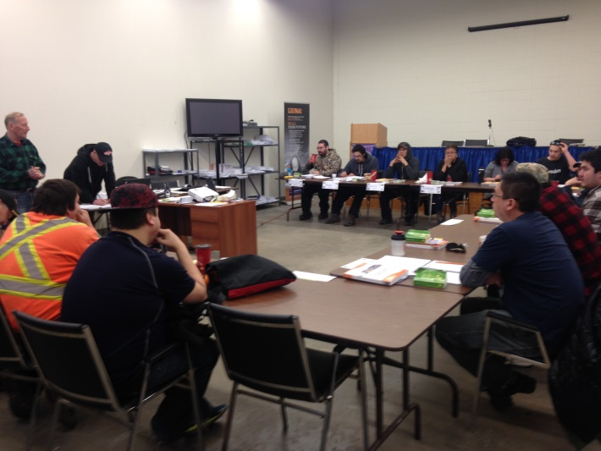
At the Union Hall
Hands on training with qualified instructors helped to prepare are participants for a career as a carpenter.
100% attendance and commitment required!

Slide 7
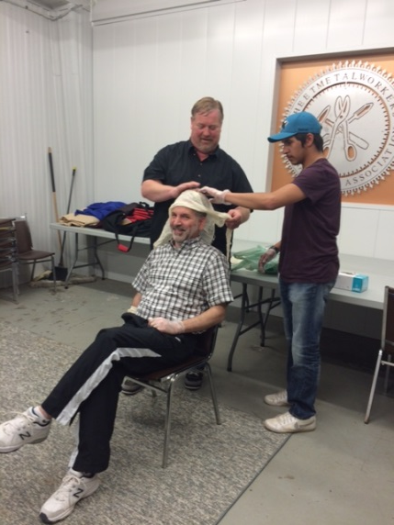
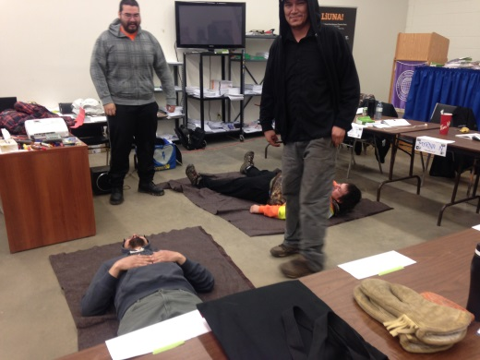
Trade Readiness Training
Workplace Hazardous Materials Information System (WHMIS)
Construction Basic Health and Safety
First Aid/CPR @ AED
Basic construction math

Slide 8
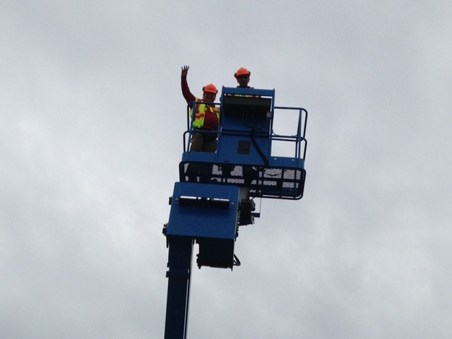
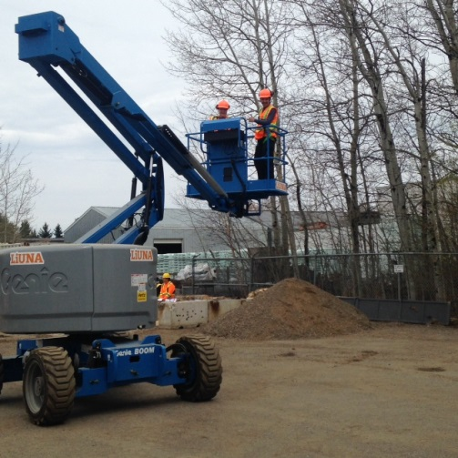
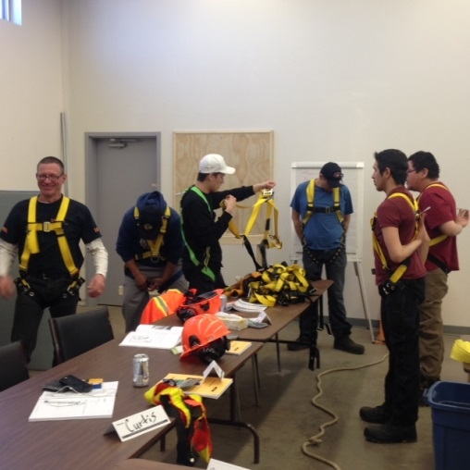
Working at Heights Learning Module

Slide 9
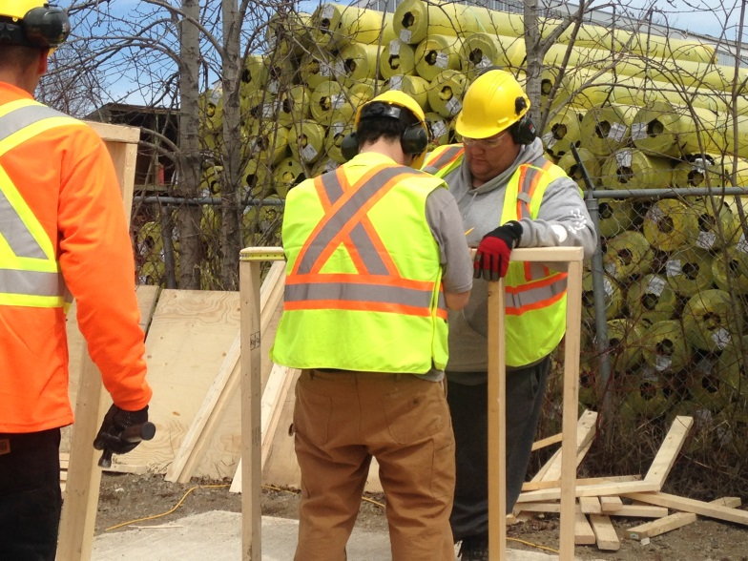
Carpentry: Safety, Materials and Tools
Drawings: Plans, Specifications
and Codes
Math: Estimating, Calculations, Basic Construction Math and Layout

Slide 10
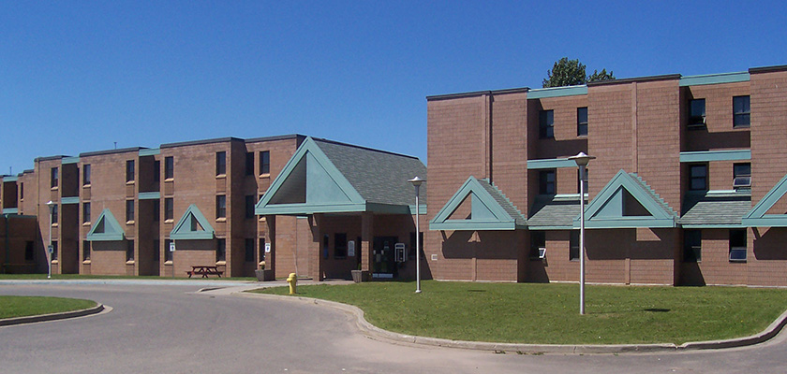
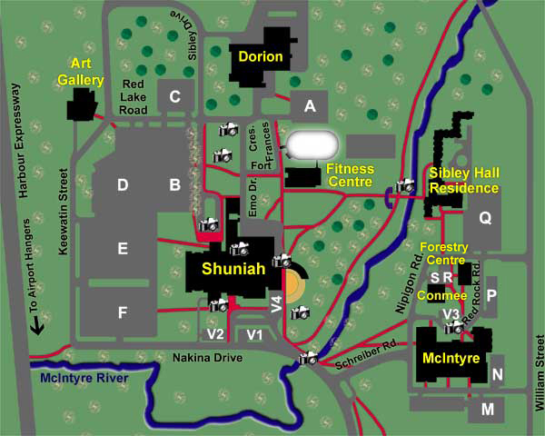
Confederation College: Sibley Hall Residence
Participants will stay at the Confederation College
Residents: Sibley Hall

Slide 11
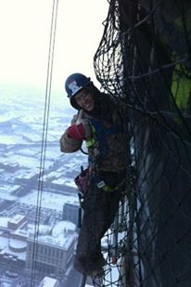
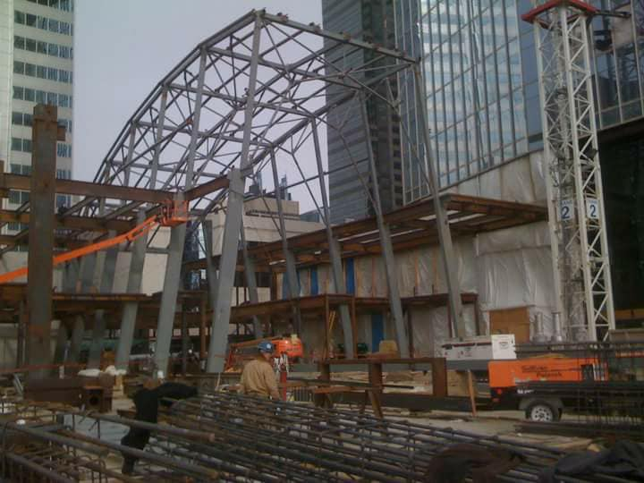
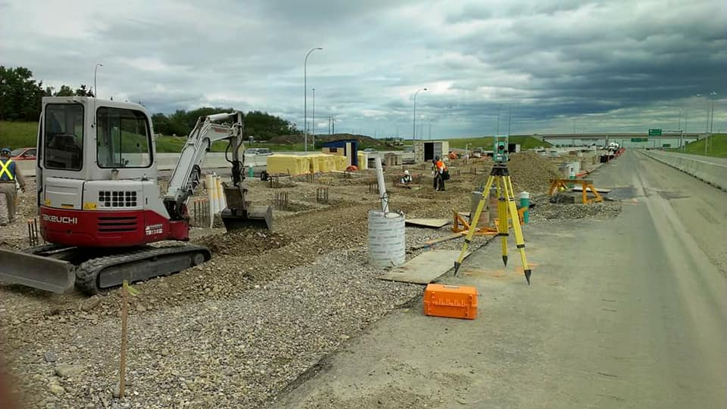
All The Possibilities!

Slide 12
Work Experience Placement
Some of our industry partners have included:
Vector
TBT Engineering
Lac Des Iles
Barrick
Northern Finishes
Superior Strategies
Robert Morriseau Contracting
Pic Mobert Housing
PRDC
Rudnicki Industrial
Thunder Bay Hydraulics

Slide 13
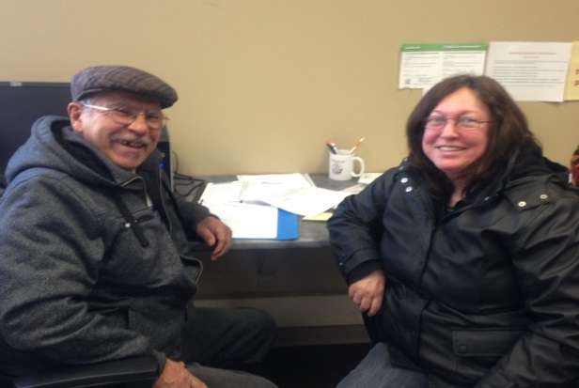
Along With…
Accommodations and healthy meals everyday
A monthly bus pass
Safety gear
Regular evening events
Bowling
Silver City

Slide 14
Applications available on the AETS Website
Program Contact:
Nancy Doblej
Project Co-ordinator
(807) 346-0307
nancy.doblej@aets.org

