Slide 1


General Carpenter (403A)
Pre-Apprenticeship Training Program

Slide 2


ANISHINABEK EMPLOYMENT AND TRAINING SERVICES
Vision
To lead in the development of a skilled Indigenous workforce empowering the Anishinabek, respectful of our culture and heritage.
Mission
To empower the Anishinabek through holistic programming, cultural sharing and skills training to employment.
By providing unique solutions to support Anishinabek to overcome barriers that are customized to individuals in their search for meaningful employment.
Promoting Anishinabek values and traditions through the development of partnerships, harnessing, creating and leveraging employment opportunities.

Slide 3

Cultural Principles
Anishinabek Employment and Training Services (AETS) recognizes and supports the strong cultural and traditional beliefs of the community, which is reflected in the organizations programs and services.
Anishinabek knowledge and values play a relevant role in the community, which is why AETS has adopted several principles which reflect the community’s history and culture.
Respect is given to each of the AETS First Nation member communities, and is inclusive of each respective traditional practice.
The Elder in Residence Program offers support and guidance for clients continuing their education and training. The Elder may offer traditional teachings, promote cultural awareness, provide guidance and offer opportunities for spiritual and personal growth.

Slide 4

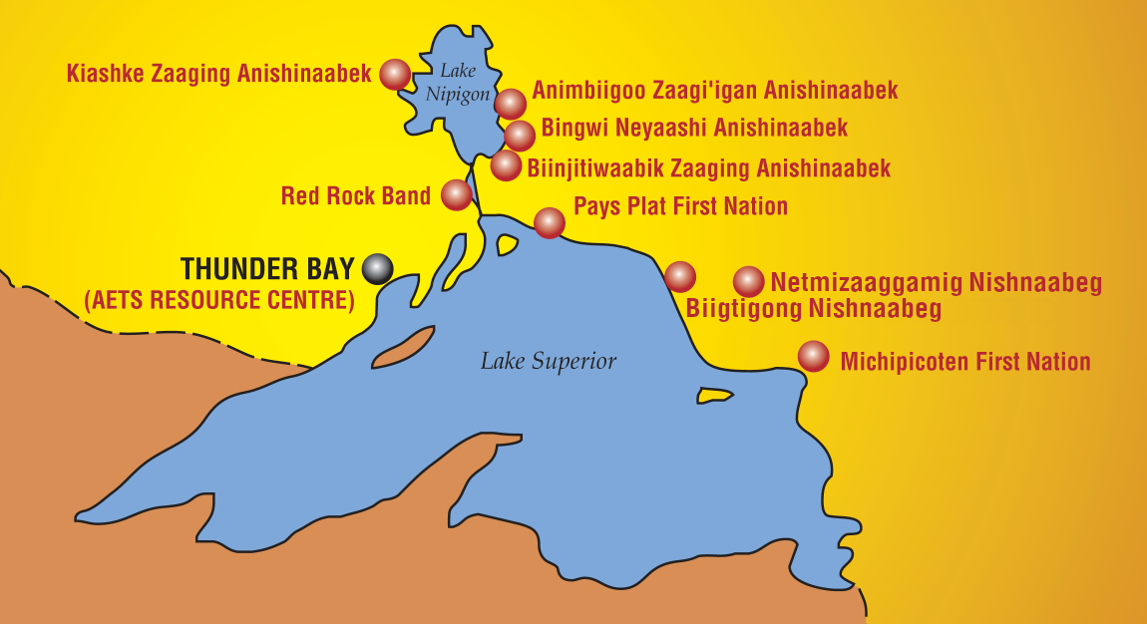
Our communities
*where seating is available AETS may consider Indigenous applicants from outside of the 9 member communities ​

Slide 5
AETS Programs
Project Based
Delivery Assistance
Disability Supports
GCP & Allowances
Job Creation Partnership
Job Development
Project Based Training
Wage Subsidy
Self-Employment Benefit
Client Based
Course Purchases & Allowances
Disability Supports
Employment Start-Up
Feepayor
Mobility Assistance
Pre-Employment Supports
Relocation/Moving Expenses
Self-Employment Benefits
Wage Subsidy

Slide 6
AETS services
Job Seeker Services
Employer Services
Workshop Facilitation
Career Pathways
Entrepreneurship Pathways
Resources

Slide 7
AETS past & Current project initiatives
Project Based
Delivery Assistance
Disability Supports
GCP & Allowances
Job Creation Partnership
Job Development
Project Based Training
Wage Subsidy
Self-Employment Benefit
Current Project Initiatives
Entrepreneurship Course 2020
Drywall 2020
Carpentry 2020
Line Crew Ground Support 2020
LMI Pilot Project – On Reserve
Board Governance Training

Slide 8
What is an apprenticeship?
What is a pre-apprenticeship?
 | Pre-Apprenticeship | Apprenticeship
Purpose | Train individual who would like to begin an apprenticeship for a trade. | Train individual who has selected a trade.
Duration | 52 weeks | Typically follow 3 – 4 year college or university program structure.
Work Experience | Pre-apprenticeships usually have a work placement portion of the program paired with a wage subsidy. | Paid on the job experience.
Hands-on Experience | Yes! | Yes!
Notes:
Pre-apprenticeships equip workers with expertise and real-life experience to help them find employment as an apprentices and eventually, as a licensed professional.
Apprenticeship’s shadow a 4 year bachelor degree programs and major universities and colleges with the completion of a 4-5 year apprenticeship. People who enroll in a pre-apprenticeship program get a head-start on succeeding as an apprentice because of the learning prerequisite skills, gaining an overview of daily expectations in their target professional field and learning strategies for getting selected into formal apprenticeships. Due to the focus on job readiness, pre-apprenticeship training includes extensive amounts of hands-on preparatory work to simulate real world application of skills and experience.
https://www.ontario.ca/page/prepare-apprenticeship

Slide 9

Why an apprenticeship?

Slide 10
AETS
General Carpentry
Pre-Apprenticeship training program
Program outline
Application
Interview
Acceptance Letter
Orientation in Thunder Bay
Math Upgrading
Welding
Carpenters Union
Job Applications
Life Skills
Health & Safety
Work Placement
Working World

Slide 11
TimeLine
Task | Weeks | Dates – Fall 2020
Application
Interview
Acceptance Letters
Orientation in Thunder Bay | 1 day | November 2020
Life Skills | 2 – 3 weeks
Math Upgrading | 1 – 2 weeks (½ days)
Health and Safety | 1 week
Welding | 2 weeks
Carpenters Union | 8 weeks
Job Applications
Work Placement | 8 – 12 weeks
TOTAL | 22-28 weeks
Current program:
September 2020
In action!
November 2020
Dates TBA!

Slide 12
APPLICATION​​
INTERVIEW​​
ACCEPTANCE LETTER
Orientation
Life skills
MATH UPGRADING​​​
HEALTH & SAFETY​
WELDING​
CARPENTERS UNION​
JOB APPLICATIONS​
WORK PLAcEMENT​
WORKING WORLD
Application Includes:
AETS Client Information Form
Pre-Apprentice Training Program Application
Consent to the Release of Information
Request for Disclosure of EI Eligibility
Cover Letter
Resume
High school diploma (grade 10 math)
Status Card (photocopy)

Slide 13
APPLICATION​​
INTERVIEW​​
ACCEPTANCE LETTER
Orientation
Life skills
MATH UPGRADING​​​
HEALTH & SAFETY​
WELDING​
CARPENTERS UNION​
JOB APPLICATIONS​
WORK PLAcEMENT​
WORKING WORLD
Interview:
Applications will be reviewed by AETS PATP program coordinator.
Successful candidates will move forward in the application process to the interview.
Candidates will answer multiple questions around experience and required supports to determine if the program is a good fit at the time.
PATP coordinators will grade interview responses.

Slide 14
APPLICATION​​
INTERVIEW​​
ACCEPTANCE LETTER
Orientation
Life skills
MATH UPGRADING​​​
HEALTH & SAFETY​
WELDING​
CARPENTERS UNION​
JOB APPLICATIONS​
WORK PLAcEMENT​
WORKING WORLD
Acceptance Letter:
PATP coordinator compiles list of successful candidates and waitlist.
AETS board of directors' review and approve successful participant list and waitlists.
Approved candidates will receive an acceptance letter outlining program dates and next steps.
Travel, accommodation, meals and daycare available to participants during the program.
Bus pass provided.
Basic safety gear provided.

Slide 15
APPLICATION​​
INTERVIEW​​
ACCEPTANCE LETTER
Orientation
Life skills
MATH UPGRADING​​​
HEALTH & SAFETY​
WELDING​
CARPENTERS UNION​
JOB APPLICATIONS​
WORK PLAcEMENT​
WORKING WORLD
Orientation Day:
Candidates meet for the first day of the program to complete orientation.
Breakfast
Meet and Greet
Complete Paperwork
Roles
Expectations
Policies & Procedures

Slide 16
APPLICATION​​
INTERVIEW​​
ACCEPTANCE LETTER
Orientation
Life skills
MATH UPGRADING​​​
HEALTH & SAFETY​
WELDING​
CARPENTERS UNION​
JOB APPLICATIONS​
WORK PLAcEMENT​
WORKING WORLD
Life Skills:
Participants will have the opportunity to experience AETS Adult Leadership Program activities. Possible activities include:
Interview Skills
Professionalism
Storytelling and Traditional Knowledge
Self-confidence and self-empowerment
Public Speaking
Leadership Skills Development

Slide 17
APPLICATION​​
INTERVIEW​​
ACCEPTANCE LETTER
Orientation
Life skills
MATH UPGRADING​​​
HEALTH & SAFETY​
WELDING​
CARPENTERS UNION​
JOB APPLICATIONS​
WORK PLAcEMENT​
WORKING WORLD
Math Upgrading:
Participants complete one week of math review and upgrading.
Allows participants to "get into the groove" of institutionalized education.
Basic construction math review.
Tutoring and 1 on 1 supports available through AETS instructor throughout the program.

Slide 18
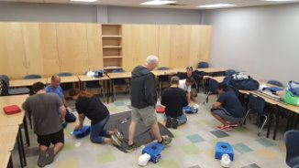
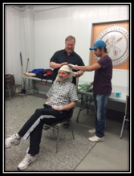
APPLICATION​​
INTERVIEW​​
ACCEPTANCE LETTER
Orientation
Life skills
MATH UPGRADING​​​
HEALTH & SAFETY​
WELDING​
CARPENTERS UNION​
JOB APPLICATIONS​
WORK PLAcEMENT​
WORKING WORLD
Health & Safety:
Join Superior Strategies in one week of Health and Safety Training.
Workplace Hazardous Materials Information System (WHMIS)
Construction Basic Health and Safety
First Aid/CPR @ AED
Fall Arrest Training
Confined Space Training

Slide 19

APPLICATION​​
INTERVIEW​​
ACCEPTANCE LETTER
Orientation
Life skills
MATH UPGRADING​​​
HEALTH & SAFETY​
WELDING​
CARPENTERS UNION​
JOB APPLICATIONS​
WORK PLAcEMENT​
WORKING WORLD
Welding:
General Carpentry participants have the opportunity to experience a secondary trade.
2 weeks of hands on welding training provided.

Slide 20
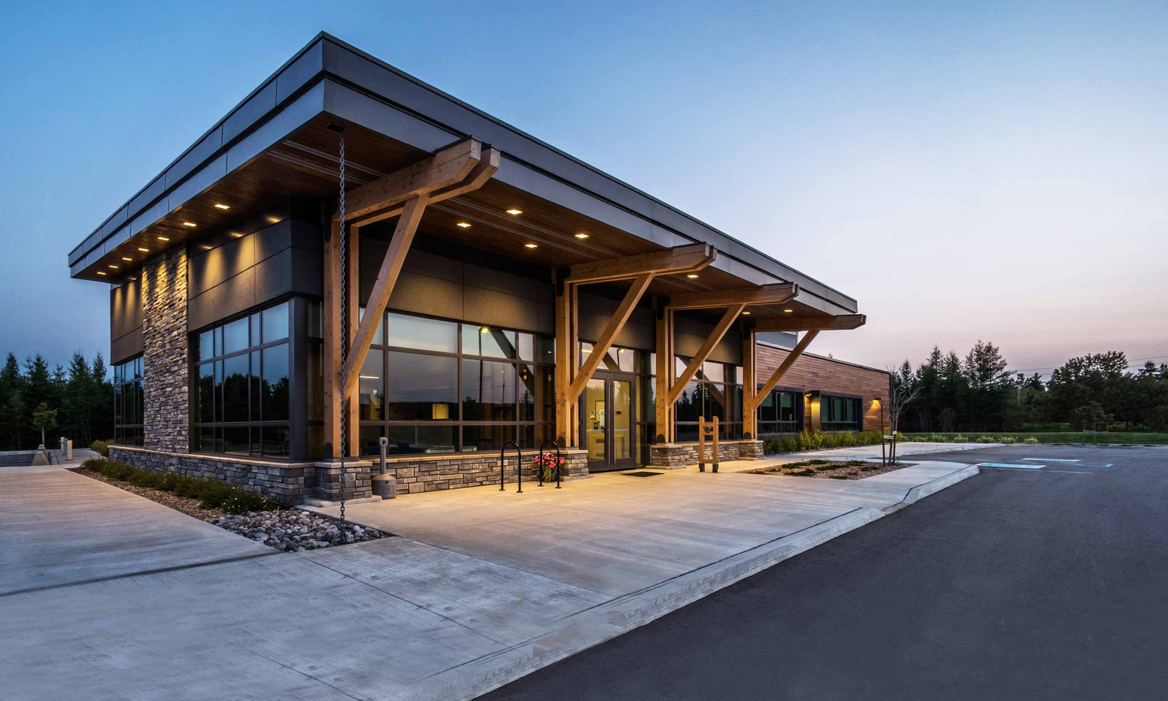

APPLICATION​​
INTERVIEW​​
ACCEPTANCE LETTER
Orientation
Life skills
MATH UPGRADING​​​
HEALTH & SAFETY​
WELDING​
CARPENTERS UNION​
JOB APPLICATIONS​
WORK PLAcEMENT​
WORKING WORLD
Carpenters Union:
Level 1 Carpentry training.
Carpenter’ & Joiners Local 1669
1306 Capital Way, Thunder Bay ON

Slide 21


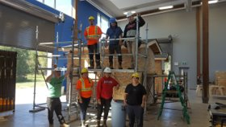
Carpenters Union:
Carpentry: Safety, Materials and Tools
Drawings: Plans, Specifications and Codes
Math: Estimating, Calculations, Basic Construction Math and Layout
APPLICATION​​
INTERVIEW​​
ACCEPTANCE LETTER
Orientation
Life skills
MATH UPGRADING​​​
HEALTH & SAFETY​
WELDING​
CARPENTERS UNION​
JOB APPLICATIONS​
WORK PLAcEMENT​
WORKING WORLD

Slide 22
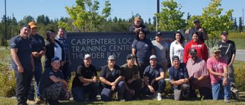
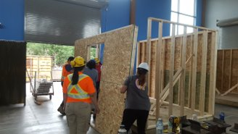
Carpenters Union:
Hands on training with qualified instructors helped to prepare are participants for a career as a carpenter.
100% attendance and commitment required!
APPLICATION​​
INTERVIEW​​
ACCEPTANCE LETTER
Orientation
Life skills
MATH UPGRADING​​​
HEALTH & SAFETY​
WELDING​
CARPENTERS UNION​
JOB APPLICATIONS​
WORK PLAcEMENT​
WORKING WORLD

Slide 23
APPLICATION​​
INTERVIEW​​
ACCEPTANCE LETTER
Orientation
Life skills
MATH UPGRADING​​​
HEALTH & SAFETY​
WELDING​
CARPENTERS UNION​
JOB APPLICATIONS​
WORK PLAcEMENT​
WORKING WORLD
Job Applications:
After completion of the program, students are provided supports for job readiness and applying for jobs.
Job search
Job Applications
Cover Letter & Resume
Interview Preparation

Slide 24
APPLICATION​​
INTERVIEW​​
ACCEPTANCE LETTER
Orientation
Life skills
MATH UPGRADING​​​
HEALTH & SAFETY​
WELDING​
CARPENTERS UNION​
JOB APPLICATIONS​
WORK PLAcEMENT​
WORKING WORLD
Work Placement:
AETS works with partners to find the best fit for the student and employer. Some of our industry partners have included:
Vector
TBT Engineering
Lac Des Iles
Barrick
Northern Finishes
Superior Strategies
Robert Morriseau Contracting
Pic Mobert Housing
PRDC
Rudnicki Industrial
Thunder Bay Hydraulics

Slide 25
APPLICATION​​
INTERVIEW​​
ACCEPTANCE LETTER
Orientation
Life skills
MATH UPGRADING​​​
HEALTH & SAFETY​
WELDING​
CARPENTERS UNION​
JOB APPLICATIONS​
WORK PLAcEMENT​
WORKING WORLD
Working World:
AETS continues to work with the student and employer in providing a wage subsidy program for program graduates. Students are employed by construction companies, carpentry contractors, and maintenance departments of factories, plants and other establishments.
Examples of possible job titles include:
Carpenter
Rough Carpenter
Renovation Carpenter
Metal Framer Carpentry
Finish Carpenter
Maintenance Carpenter

Slide 26
Questions & Comments
For more information contact:
Miigwech, thank you!
Matt Gladu​
PATP Coordinator​
Matt.gladu@aets.org​
Ash Laframboise​
Teacher, PATP Coordinator​
Ashlie.laframboise@aets.org
Visit us online at ​
www.aets.org

