Slide 1


Aircraft Maintenance Technician (AMT)
Date: ________________, 2018
Location: Anishinabek Employment & Training Services boardroom
Thunder Bay, ON
Notes:
Good day/morning
I’d like to welcome you to our information session, affectionately referred to as AMT 101
My name is: ____ and I am a :___________ with the AETS Mino Bimaadiziwin pilot project (pass out your business cards too). I’m really happy to be able to share with you today some information about our new AMT training program.
I would ask that you please fill in our sign-in sheet with your name, email & phone number as we get started
If there are any questions as we go along, let me know and there’ll also be time at the end of the session for questions
If there’s a question that’s a stumper/I can’t answer today, I’m going to write those down and I promise to get an answer back to you with your phone and email coordinates.

Slide 2
Outline
Your AETS and Mino Bimaadiziwin
AMT - Is it right for you?
AMT Role, Duties and Career options
What You Need to know
Program courses
AETS Supports
Training date & place
How to Register
Admission Requirements
Questions
Notes:
This is an outline of the topics we’ll be looking at
Some background on AETS and our Mino Bimaadiziwin project
A look at the AMT training program
An outline of what being an AMT is as a career – It’s really a thumbnail sketch and to get more it takes research on your part, speaking with people who are in the career, or at the school to find out more.
We’ll go over what you need to know for AMT training, what our project has available to help, and if AMT is right for you how to take those next steps to Apply.

Slide 3
Your AETS
Federally funded employment & training programs and services
  Soft services
  Workshops
  Sponsored programs
  Special projects
Mino Bimaadiziwin
Federal Skills Partnership Fund pilot special project (to March 2021) with Life Skills and accredited training in:
  Aircraft Maintenance Technician,
  Industrial Millwright,
  Employment Officer,
  Forestry & Mechanized Harvesting,
  Line Cutter,
  Line Crew Ground Support,
  Sawmill Worker,
  Personal Support Worker,
  Driver’s Licence and Upgrading
First Nations Pre-Employment and Education offers a new, alternative education model,
Teacher access,
Prior Learning Assessment Recognition and
classes for high-school credits
Notes:
AETS is your Employment & Training programs/services provider for Citizens on & off reserve in the 1850 area. AETS has provided services over 20 years, under 5 year federal agreements. AETS reports to a Board of Directors representing our communities. AETS provides:
Soft services (Career counselling, job search, resume writing, interview skills)
Workshops (Career Choices, Personality Dimensions)
Sponsored programs (ie Starting a Business, training sponsorships, employability supports, mobility supports, etc.)
AETS has applied for project funding (ie Skills Partnership Fund) like Mino Bimaadiziwin, running to March 2021, delivering specialized training in areas, such as AMT, including Elders support, Life Skills and other unique supports. A related support, the First Nations Pre-Employment & Education program is an alternate education model for off & on-reserve Citizens, with access to a Teacher, PLAR and credits to complete an OSSD.

Slide 4
AETS Communities
Notes:
AETS works with Citizens from these 9 communities of the 1850 Treaty area
both on & off reserve. For Pays Plat east to Michipicoten Joni Michano is your Project Officer. From Red Rock Indian Band and west to Kiashke Zaaging Anishinaabek, Bonnie Cordone is your Project Officer.
Our funded training programs are focussed on our community members and may be open to other First Nations if we have seats that are not filled by our community members .

Slide 5
AMT – Is it right for me?
Looking for a ?
Career in high demand
Vital, valued role in Aviation inspection
and maintenance
AMTs must be able to
Follow Transport Canada regulations
Climb ladders, use hoists or crawl into tight
spaces to inspect and make repairs
Demonstrate high mechanical aptitude.
Problem solve
Time manage
Communicate in writing and in person
Work independently or on a team
Works shifts and with a varied workload
Notes:
Aircraft Maintenance Technician is our next training program in this pilot project, and not our last. Deciding on if an AMT career is right for you is a process . (Hand out the Career Research Tool.)
Making the right choice to invest your time & energy, you want to be sure, to Know yourself, your: interests, talents/skills, strengths, what you do and do not like to do
Family & friends will have their insights to offer, your hobbies and what holds your curiosity/interest will also give you clues to if this is a good career match for you.
Perhaps you’ve had experience working with small engines, electrical projects, power systems or mechanics, or you enjoy trouble shooting on systems and solving puzzles.
Career Awareness comes from research: online, reading, Career Counselling, meeting Employers/AMTs, checking out the school, job ads, job trends & prospects, career paths & options to make a SOUND choice for you.
Things to consider include: job satisfaction, the rewards, feeling secure about your choice, and how you can use these skills to make a difference in your life, your family, community and in the world
Then Take Action. Look at skills you need to develop Apply, and get on the path to Learn to Earn.

Slide 6
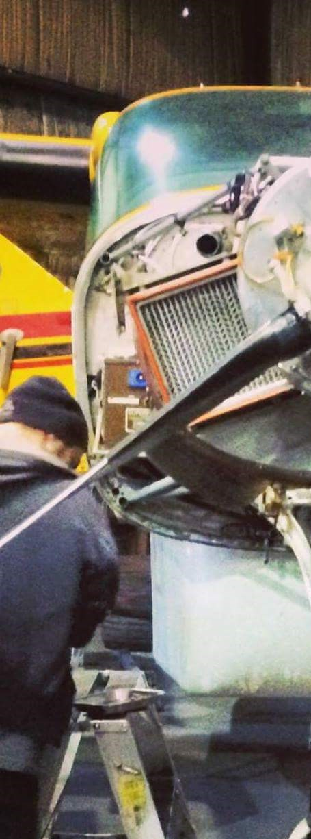
AMT Roles
AMTS may work on one or many types of aircraft (jets, propeller planes, and helicopters).
In larger shops, AMTs can specialize (i.e. airframe, engine, hydraulic, or electrical).
In smaller shops, AMTs work on varied components.
It’s ‘up close’ with the equipment.
There’s a bond of trust with the Employer, airline, pilots and passengers in your work.
AMTs add to the life span of very expensive aircraft.
The work includes regular maintenance and unique repair problems.
AMTS work indoors, sometimes outdoors (in multi-level and unionized settings).
With experience and education, AMTS can apply to move into jobs as inspectors, teachers, and engineers.
Notes:
AMTs can have many roles. The courses will teach what you need to know to write for Transport Canada licenses to maintain, repair & troubleshoot aircraft systems such as: electrical & electronics, airframe systems & inspection, and rotary wing (helicopter).
It’s investigative & problem solving. There’s scheduled maintenance and then there’s what crops up in a pilot’s pre-flight check, a problem to find & fix, say a fuel gauge doesn’t work. To solve that, AMTs troubleshoot the systems, use test equipment, check for broken or shorted out wires, and replace defective components.
AMT’s are a unique resource for keeping high value equipment up and flying safe.
AMTs are based out of hangars but can work out of doors too
There’s no shortage of work for AMTs. Normally with major & regional carriers, it’s a job that can have opportunities world-wide.

Slide 7
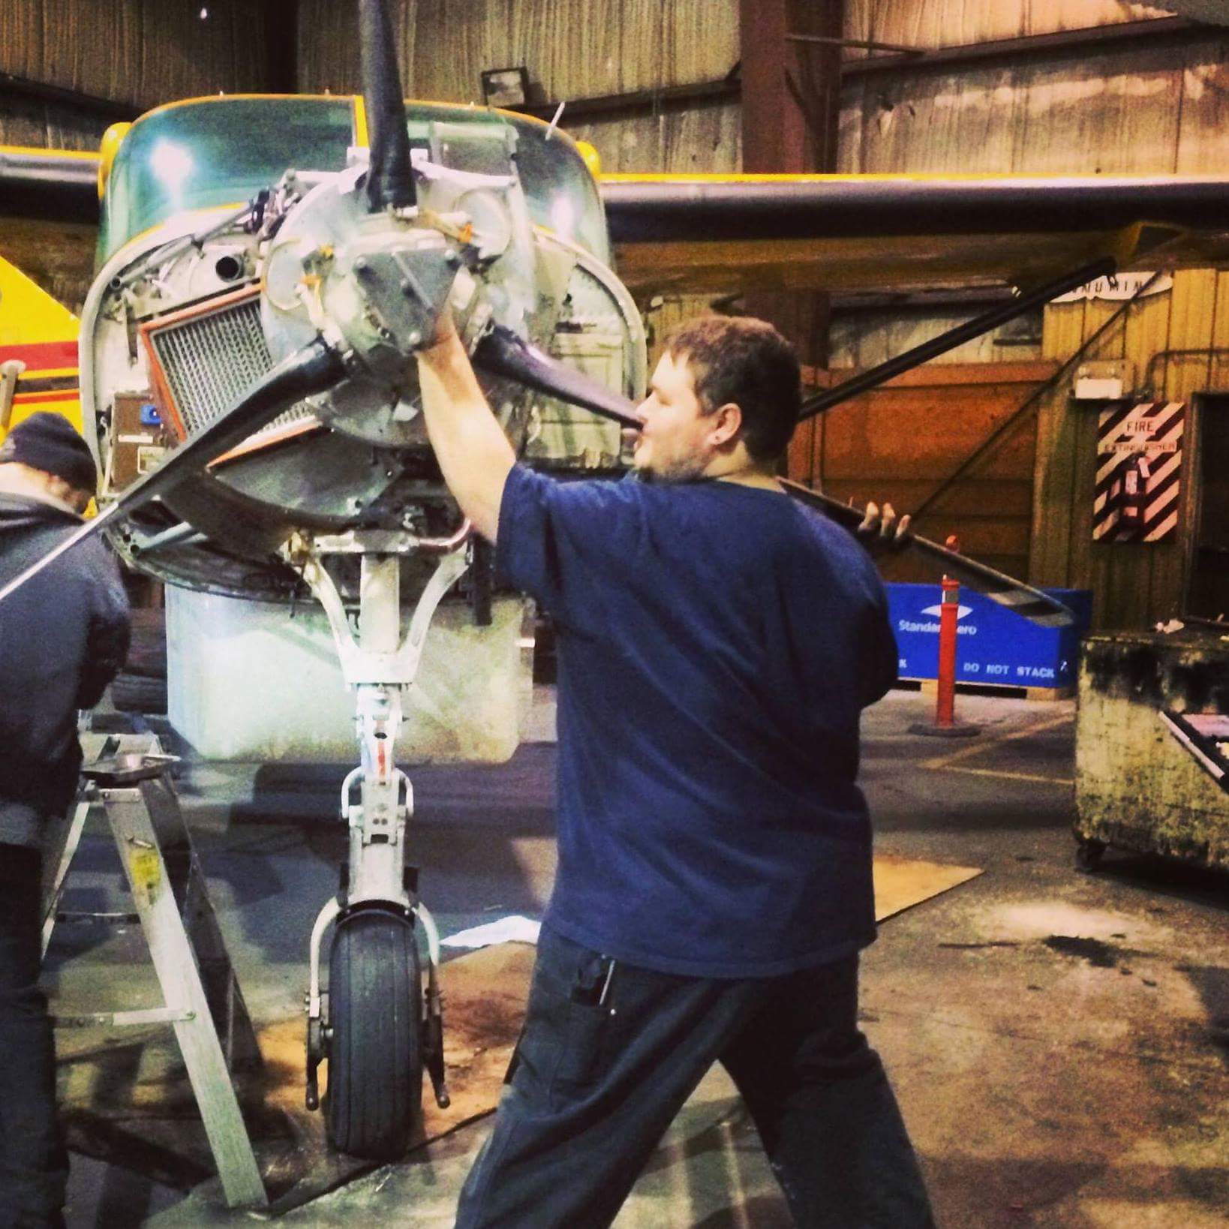
AMT Duties
Depending on the setting, AMTS will
Inspect systems
Diagnose & troubleshoot systems
Repair & replacement components
Perform preventative maintenance
Check for wear and tear
Test their work
Keep work records, order parts
Follow technical specifications, and
regulations.
Wear protective gear, noise cancelling head
phones and work safely with chemicals,
and large power tools.
Notes:
An AMTs work depends on the setting. When planes and helicopters land, they must be thoroughly checked prior to takeoff within a few hours of landing, regardless of the time. Normally they are expected to perform in shifts at any hour of the day or night. Overtime and weekend work is common with this type of job.
There’s a fair bit of on the job learning, but you have to have the College background to start.
AMTs must be able to perform detailed tasks and record their work, often in a short amount of time. AMTs have to be able to keep a cool head in stressful conditions.

Slide 8
AMT Job Titles
Aircraft mechanics and aircraft inspectors (NOC 7315)
Accessories overhaul mechanic (or techn) Aero-engine mechanic (or techn) Composite repair technician Aircraft accessories mechanic Aircraft accessories overhaul mechanic Aircraft accessories repairer
Aircraft body repairer Engine tester, aircraft Experimental aircraft mechanic Engine accessories overhaul mechanic Engine overhaul mechanic, aircraft Aircraft composite & sheet metal repairer
Aircraft engine inspector, mech (or techn)
Engine overhaul inspector, aircraft mechanical systems
Notes:
There are a lot of variances in AMT related jobs – depending on the employer, if you’re working with large or smaller aviation operations, and many different real world job titles that a trained AMT can go by. Here are few that are classified alongside AMT and related occupations in the National Occupation Classification system.

Slide 9
AMT Job Titles
Aircraft eng. mechanical systems technician Aircraft engine overhaul inspector
Aircraft eng. overhaul inspector, mech’l syst Aircraft engine overhaul mechanic
Aircraft eng. repair & overhaul mechanic Aircraft engine tester
Aircraft gas turbine engine technician Aircraft hydr. inspector, or mech
Aircraft hydraulics shop technician Aircraft hydraulics tester
Aircraft inspector, mechanical systems Aircraft inspector
Aircraft maint. engineer (except avionics) Aircraft maint. eng, mech’l systs
Aircraft maint. engineer, rotorcraft Aircraft maint. Eng. structures
Aircraft maint. mechanic apprentice Aircraft maint. technician

Slide 10
AMT Job Titles
Aircraft mechanical & fuel systems overhaul & repair mechanic
Aircraft mech’l systems inspector Aircraft mech’l systems preflight Aircraft mech’l systems technician Aircraft mechanic
Aircraft mechanic, engine access.overhaul Aircraft mechanic, engine overhaul
Aircraft mechanic experimental Aircraft mechanic, flight tests
Aircraft mechanic, mechanical systems Aircraft mechanic, power plant
Aircraft plumbing and hydraulics mechanic Aircraft propeller systems techn
Aircraft reciprocating engine technician Aircraft repair & overhaul inspector
Aircraft repair shop inspector Aircraft safety systems mechanic
Aircraft sheet metal technician Aircraft skin repairer
Aircraft mech’l systems repair inspector/ repair shop inspector

Slide 11
AMT Job Titles
Aircraft structural repair technician Aircraft structural technician
Aircraft systems inspector Aircraft techn, accessories overhaul
Aircraft techn, gas turbine engines Aircraft techn, mechanical systems
Aircraft techn, propeller systems Aircraft technician, propulsion
Airframe mechanic Apprentice aircraft maint. engineer
Apprentice aircraft mechanic, mechanical systems
Apprentice AME (aircraft maintenance engineer)
Aviation maintenance inspector
Aviation mechanical component shop technician

Slide 12
AMT Job Titles
Flight line mechanic Flight test inspector
Flight test mechanic, aircraft Gas turbine engine mechanic
Helicopter inspector, mechanical systems
Helicopter mechanic Hydraulic mechanic, aircraft
Hydraulics technician, aircraft Inspector, aircraft
Inspector, aircraft engine overhaul Jr mechanic, mechanical systems
Inspector, aircraft engines Insp, aircraft mech’l systems flight tests Inspector, aircraft systems Maintenance technician, aircraft
Inspector, aviation maintenance Inspector, repair and overhaul

Slide 13
AMT Job Titles
Mechanic, aircraft engine overhaul Mechanic, aircraft engines
Mechanic, aircraft mechanical systems Mechanic, airframes
Mechanical and fuel systems overhaul and repair mechanic, aircraft
Mechanical systems inspector, aircraft repair and overhaul
Mechanic, gas turbine engines Mechanic, preflight
Modification mechanic, mech’l systems Power plant mechanic, aircraft
Preflight mechanic Preflight mechanic, mech’l systems
Propeller inspector, aircraft Propulsion technician
Repairer, aircraft bodies Repairer, aircraft skins
Repairer, aircraft accessories Rotary techn, aircraft mech’l systems
Rotorcraft maintenance engineer Rotorcraft mech’l systems technician

Slide 14
AMT Job Titles
Safety systems mechanic, aircraft Sheet metal technician, aircraft
Shop inspector, mechanical systems repair
Shop inspector, aircraft repair
Shop technician, mech’l components
Structural repair technician Structures mechanic
Techn, aircraft engines Techn, gas turbine engines
Techn aircraft hydraulics shop Techn, mechanical systems
Techn, propeller systems Techn, reciprocating engines
Techn, composite repair Techn, rotorcraft mechanical systems

Slide 15
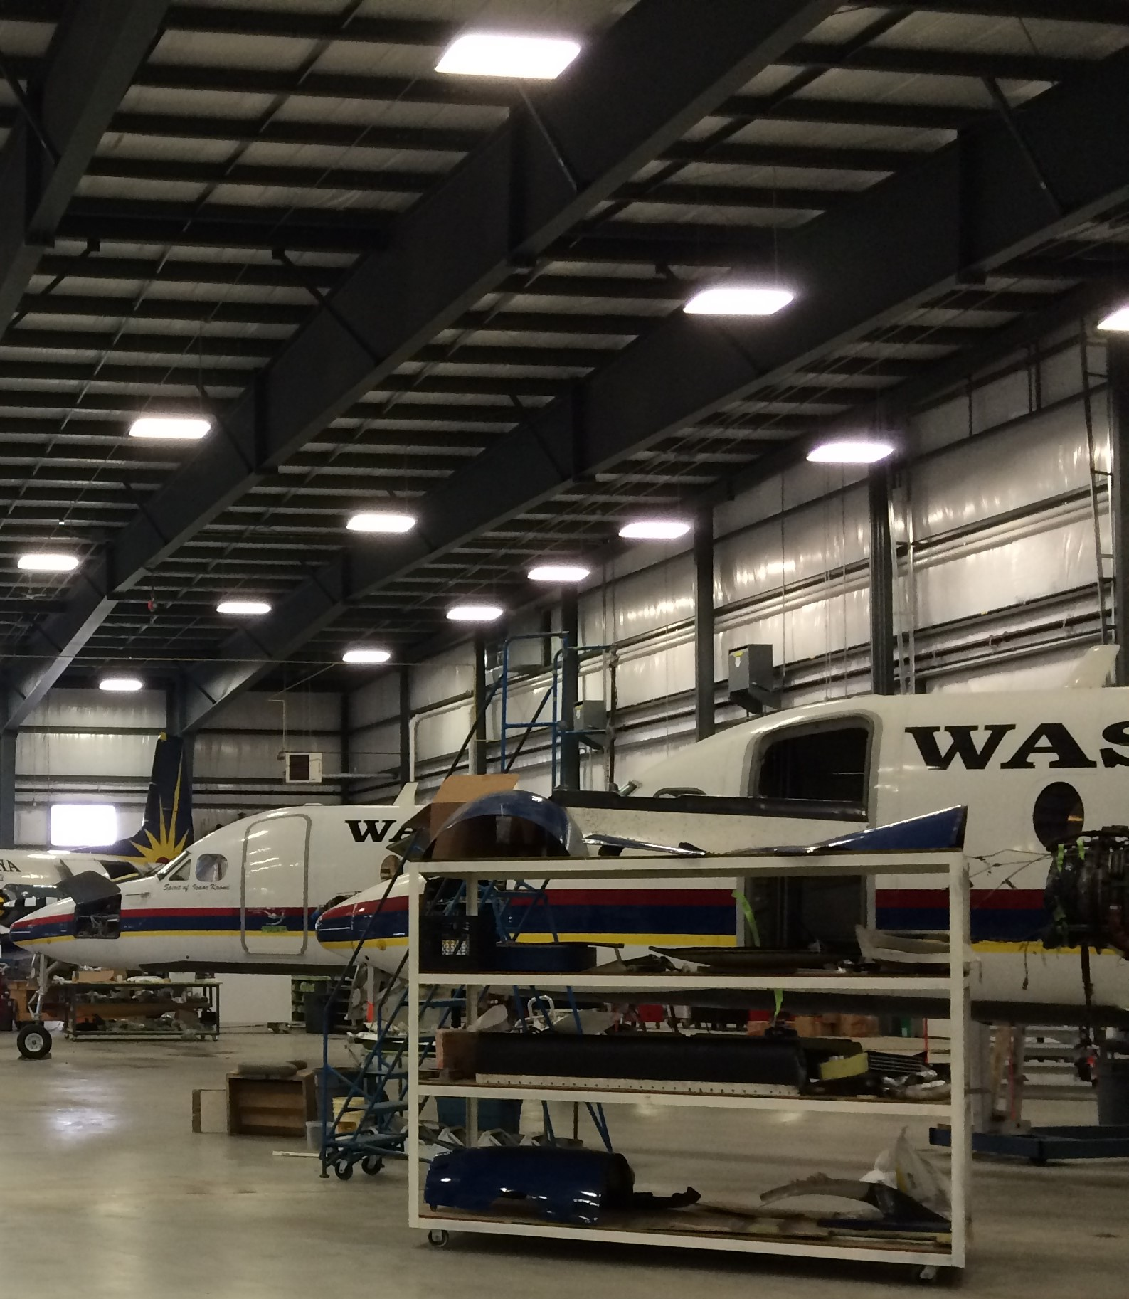
Alternate Career Paths
Engineer
Inspector
Specialized systems
Planes, jets, helicopters
Design
Own business
Notes:
For some, AMT can be a springboard to another career in technical , mechanical, engineering or inspector’s services or along the aviation continuum. AMT experience working with local, regional and larger scale commercial airlines, even hospitals and major corporations have their own aircraft, combined with added study (AETS or post secondary funded) can lead into these diploma and degree areas. Another option is to become your own boss, and form your own business.
Self-Employment is an option to start your own business (AETS might be able to help with a self-employment benefit to help as you develop and implement your own business plan )

Slide 16
Labour Market Demand
Toronto has 1700+ AMTs and the jobs outlook is bright. On March 6th , over 20 AMT related job ads were posted.
Thunder Bay is a centralized hub for airlines, aircraft and flight operations
Baby boomer workers are retiring
Employment growth, new jobs with regional, domestic and other providers
Major Employers are looking for Indigenous workers
Staff reflecting the passenger community
Employers appreciate the value and contributions of First Nations workers
AMTs careers have options for movement
Notes:
In the Labour Market, AMTs have valuable skills, and Employers are the buyers. Many factors are involved with the AMT Labour Market. Demand for workers, drives up prices.
Ontario has multiple airlines and carriers regional, domestic and international as well as equipment manufacturers.
Thunder Bay is a transportation hub for helicopters (Hospitals), airlines, and even for drone flight operations.
Wasaya, a major employer, has its own equipment hangars and an expanding fleet. It is positioned as a prime Indigenous Employer. They appreciate First Nations workers’ quality of training and it makes good business sense that workers reflect the communities they serve.
In Toronto alone there were 20 AMT positions posted on March 6th and opportunities are available Canada wide and internationally.

Slide 17
AMTs in Ontario
Toronto area 1,720 AMTs
In the following sectors:
  Transportation & warehousing: 58%
  Transportation equipment manufacturing: 32%
AMT Wage Estimates Ontario 2014-15
Low | Median | High
$15.00 | $25.00 | $36.59
Notes:
AMTs in Ontario (Toronto specifically) as of March 2018:
1,720 AMTs work in this sector
mainly in :
Transportation and warehousing equipment: 52%
Manufacturing equipment : 48%
The wages can range greatly in terms of shop sizes etc.

Slide 18
REQUIREMENTS ON THE JOB
In General
Some tasks require the ability to lift 15-19 kgs (30 – 40lbs) and
other jobs that require force used on tools to do the work.
Some jobs involve work in confined spaces or working on the floor under an aircraft.
You may work with sensitive and high value equipment and need to be able to
  protect yourself and
  ensure the safety of others
Notes:
Many employers ask for a criminal records check and drug testing.
This is because of the importance of the work and the value of the equipment you are servicing.
It’s a protection for you and for the people who rely on your work.
If any Criminal Reference Checks or other testing is required by the College, for students who are approved by AETS may be able to reimburse original receipts. It takes time to get CRC’s and testing done.
An outline of the specific AMT requirements is available through AETS and also from the College website.

Slide 19
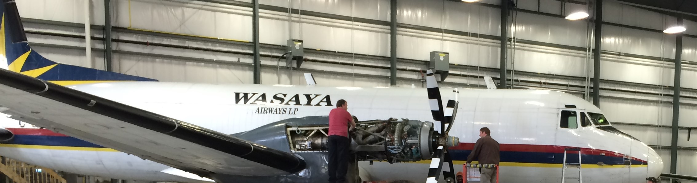
Things you need to know
A 2 year College program (unsponsored during the summer months)
  Strict attendance and punctuality in school and work
  Personal commitment & dedication
  Home work & assignments
  Healthy lifestyle and clear criminal record
Weekdays 9 am – 4 pm
  classroom & labs
Notes:
With this program there are some things you need to know
Normally this is a 2 year College program .
It’s a strict program and takes dedication and commitment, drug free and a clear criminal record.
The program is a steady canoe , paddling steady to stay on track and each person depends on each-other
It mirrors conditions in the real world. The Employer, staff team and airline depend on the AMT being focussed ready and on time, reliable and responsible. Its why being on time and attending school every day is important. Lack of attendance is a reason that a sponsorship could be ended early.
The bulk of time is spent in the classroom and in labs at the school to try and to test those skills in different real world type conditions.

Slide 20
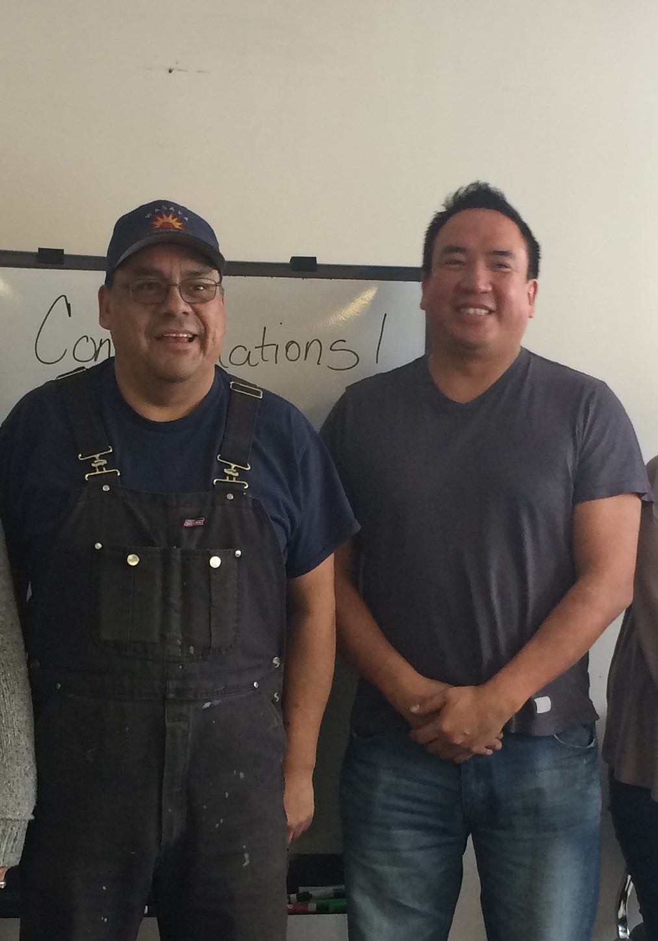
Program Courses
Persuasive Writing
Aviation Math
Aircraft Construction and Science
Flight , Circuitry
Reciprocating Engines & maintenance
Power Generation/Distribution
Gas Turbine Powerplants & maintenance
Airframes
Flight Control & inspections
Notes:
Persuasive Writing - Persuasive Writing strengthens writing clearly, correctly, reading and critical thinking to get at the details
Aviation Math, Aircraft Construction and Science , Flight , Circuitry ,Reciprocating Engines & maintenance , Power Generation/Distribution , Gas Turbine Powerplants & maintenance
Airframes, Flight Control & inspections

Slide 21
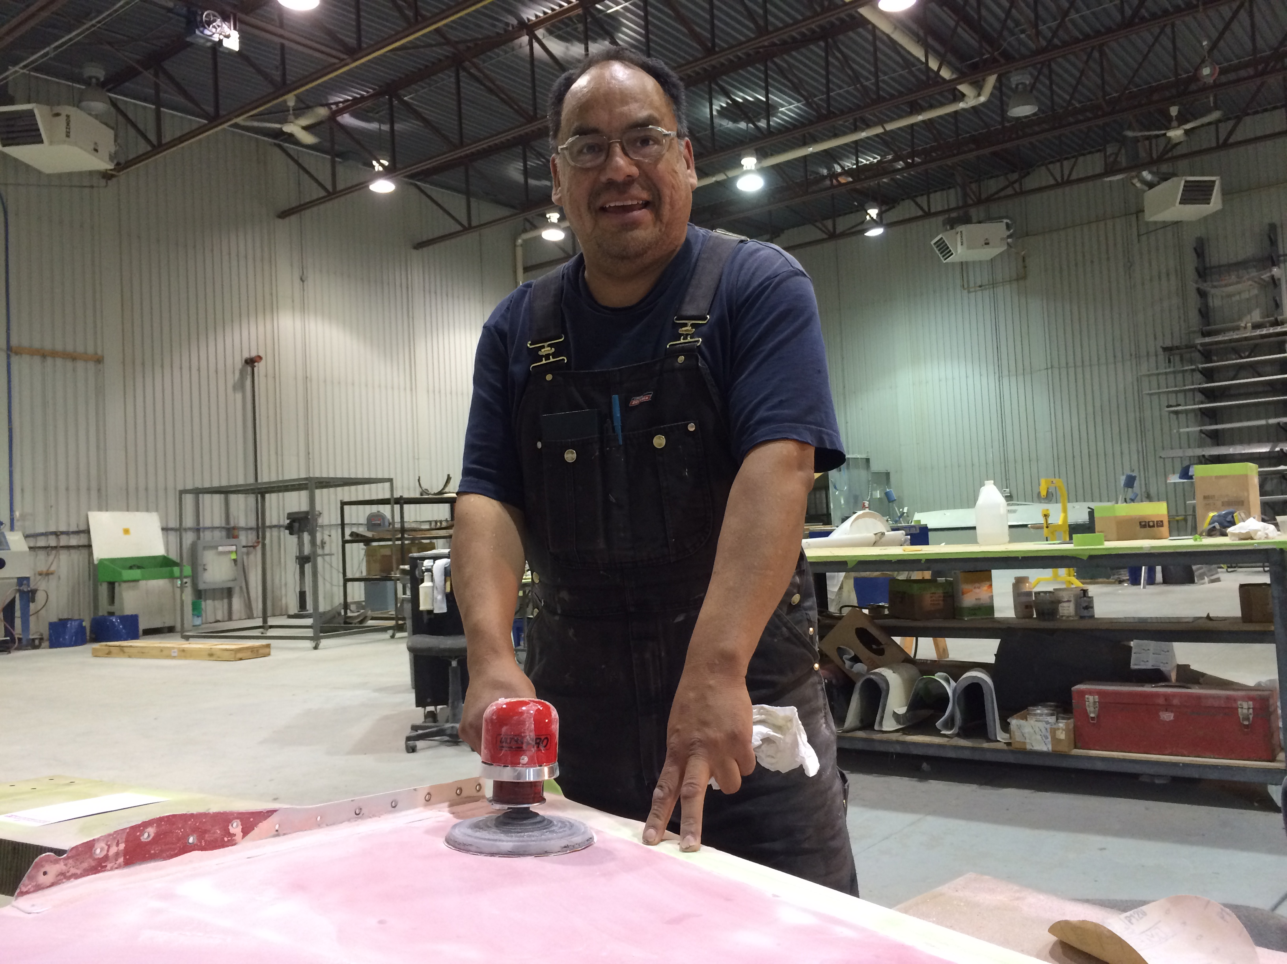
Program Courses
Rotary Wing aircraft & maintenance
Composites ,
Aircraft Systems & Inspection,
Avionics Maintenance,
AME Responsibilities,
Aviation Regulations, Lab Skills – simulated
Notes:
Rotary Wing aircraft & maintenance
Composites , Aircraft Systems & Inspection, Avionics Maintenance, AME Responsibilities, Aviation Regulations, Lab Skills – simulated to practice what you’ve learned in the theory classes

Slide 22



AETS Supports
These supports and subsidies are available as needed:
Sibley Residence (single)
Tuition & Books
Students pay for stationery
Living Allowance
Meal Allowance
Bus pass/travel
Uniform & Footwear
Specialized tests
Child Care Subsidy
  Students arrange for the childcare provider
2 Group Choice evening events
Travel home up to 2 trips
College events
  Residence, Apiwin and
  Student Support Services
    Life Skills (August 2018)
    Tutoring
Notes:
While all this is happening a student can expect support from Mino Bimaadiziwin (AETS)
Basically our strategy for success is to address the factors that could otherwise hold a student back.
It’s about being welcome, two-way respect, working together (AETS, Students, College, Employers, Students Support Services , Apiwin, Elders and agencies like NEW).
It’s about Tuition coverage & Books that are ordered/delivered for 1st day of class.
Uniform/shoes are fitted & ordered for you. Pens & paper though, is a student responsibility because otherwise it would reduce the number of students we’d be able to sponsor
Allowances can help subsidize Living, Meals costs and Bus Passes. (We’ll have drivers with vans too.) Child care is a Subsidy, but the student arranges for a provider. It may not cover all of the costs.
For single people coming in from out of town we have Sibley Residence (single only, bed desk, dresser, microwave & mini fridge, co-ed private bathrooms/showers, common rooms & laundry facilities 24/7).
In School its about : Regular attendance (weekly reports), Punctuality: mandatory to keep up with school & placement. Mino Bimaadiziwin staff will provide daily in class contact.
We track results and student satisfaction, through evaluations throughout the training
Tutors & Services are available for: note taking, study skills, Test skills, (Student Success Centre/Apiwin) . It’s about supporting an environment for Teamwork, study groups, and a shared PSW Facebook page. It’s about connections, networking and social events that all helps with success.

Slide 23
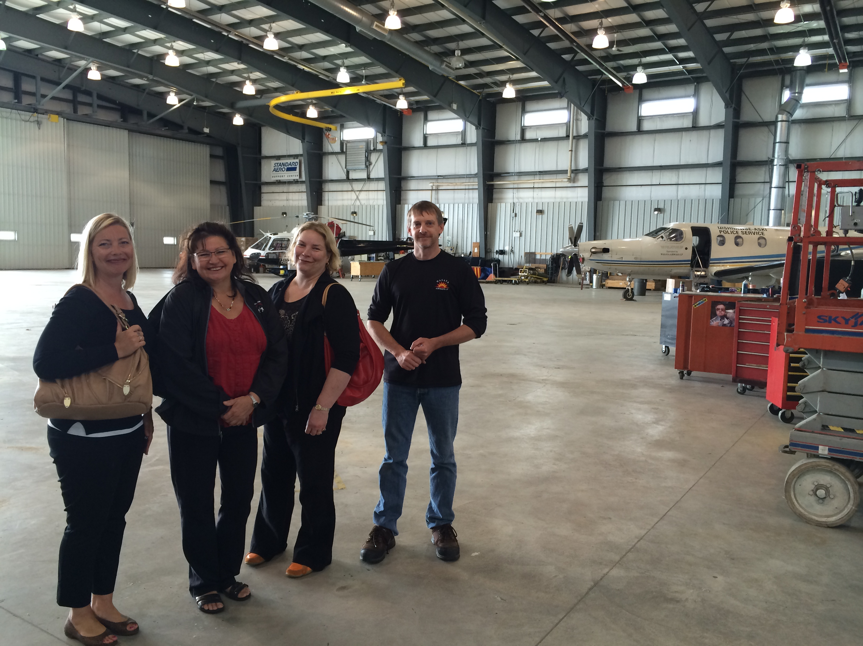
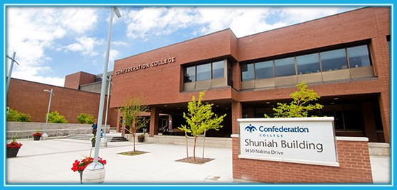
Training Begins – Sept 4th, 2018
Breakfast and Orientation
Course schedule, books and uniforms
Program overview and your responsibilities
Workshops and speakers
Tour of the classes and labs, and residences
Overview of supports
Notes:
Training Day 1 starts with an orientation session to get to know the School, getting together information and supplies, getting to know your fellow classmates and finding out about the available supports

Slide 24
I’m Interested, How do I Start?
Application and consent forms
are on the aets.org website
    Grade 12 English and Math or equivalent
    Status card or letter
Deadline
Fri. July 6th 2018, 12:00 NOON
Notes:
Applications are due on: (date) Noon
Application package includes:
AETS and Mino Bimaadiziwin Applications, and consent forms, reference check and medical testing, Proof of admission eligibility (diploma/transcript), proof of status, career research and essay or alternate visioning format

Slide 25


Admissions Requirements
OSSD or GED with Gr 12 English (C/U) level
Mature Student Assessment or Academic and Career Entrance
Recommended courses:
Gr 12 “Foundations for College Maths” (MAP4C) and/or
Gr 11 Physics.
High-school credit classes and PLARs are offered
through AETS

Slide 26

Questions – Thank you
For more information about our programs or how to apply, please call:
AETS Office: 807-346-0307
Joni Michano – Eastern Officer cell 807-631-5838
Bonnie Cordone – Western Officer cell 807-631-9287
Notes:
I’m passing around an evaluation form for this information session, how we did and your feedback is important.
We use your thoughts to help improve our programs and sessions, and it’s important to our success. The forms can be filled in and left here on the table or with me. You can also contact us about this program and any of our other upcoming programs, or refer people to get in touch with us. We’d be happy to share this information with everyone.
Please do help yourself to the refreshments available and thank you for your time.
Any questions?

